Slide 1
North Northants Sports & Welfare Club
BRINGING DIVERSITY TO LIFE IN NORTH NORTHANTS
PRESENTATION BY:
KELVIN SINGH
CLUB VOLUNTEER

Slide 2
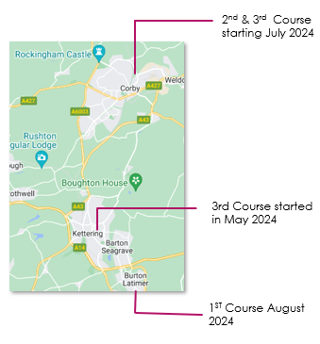
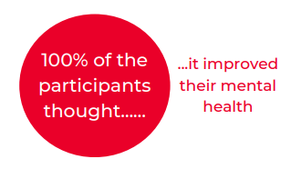
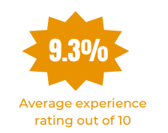
FREE Women’s Keep Fit & Self Defence Course – BE SAFE CAMPAIGN
COURSE DETAILS
LOCATIONS
13 Week FREE COURSE
Self Defence Techniques
Identifying signs of danger
Violence Prevention & De-escalation
Kicking Techniques
Knife Blocks
Strangle Hold Techniques
Community Group Speakers
Mental Health Talks
Each participant is provided with safety equipment
The Impact

Slide 3
2024 OPPORTUNTIES

Slide 4
2024 PARTNERSHIP OPPORTUNITY
NNS&W have obtained funding to host a Mela to help bring people together.
PROJECT PROPOSAL: NNS&W partnering with the Love Food festival will support costs for marketing, security & operations and provide South Asian entertainment along with stage and Screen set up in Wicksteed Pavilion for live music on the day.

