Slide 1
REDEVELOPMENT PROJECT

Slide 2
Project Aim
To provide a
building suitable for
21st century worship
and supporting
community events

Slide 3
Project Objectives
COMFORTABLE throughout the year
ACCESSIBLE for all visitors: choir, clergy and performers
SAFE for everyone using the church
ADAPTABLE for the needs of the next generation
SUSTAINABLE into the future

Slide 4
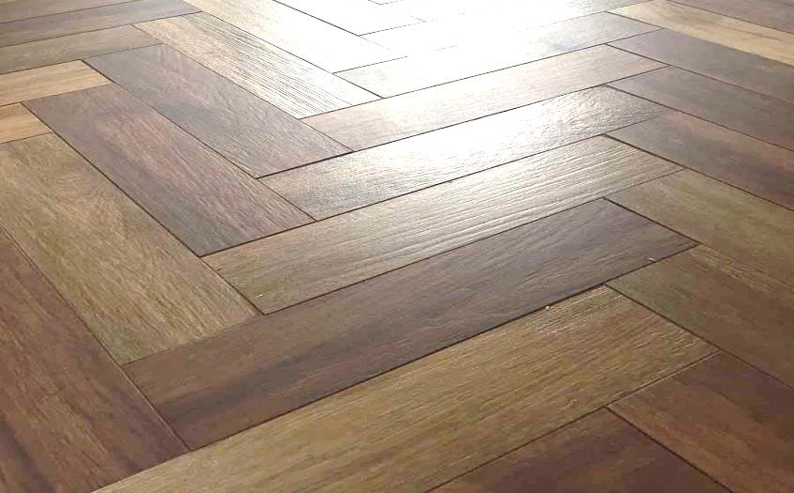
Flooring
The old wooden flooring was unfit for purpose. It was lifting making it unsafe for all to use
The new ceramic tiles are non-slip and a safe surface for all the activities which take place

Slide 5
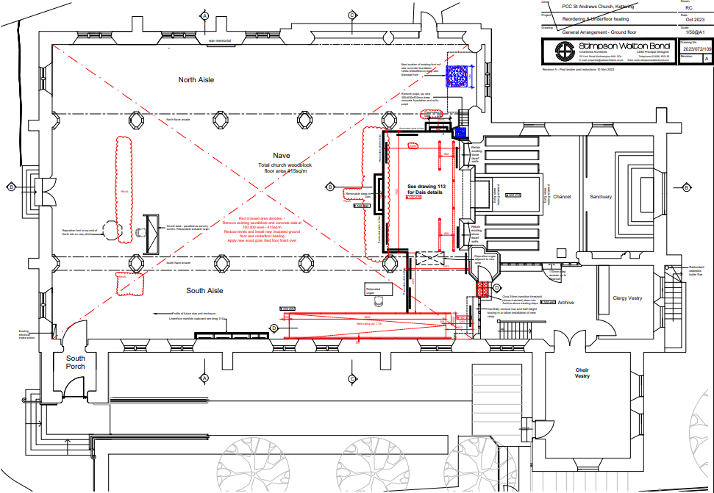
Work
carried out
Works to be carried out

Slide 6
Included in this phase
Increasing the area of the dais / stage
Installing a ramp
Removal of the side altar
Moving the font
Moving the sound desk and organ
Underfloor heating

Slide 7
Not included in this phase
Servery area
Lighting
Replacement seating

Slide 8
Seating Update
We have successfully obtained permission from the Diocese to replace all of the 1930’s wooden chairs
We have just launched a funding initiative for individuals or groups to purchase a chair or part of a chair! (Arms, linking bolts, nonslip protective feet)
Our aim to have 200 chairs in church ready for the official launch weekend in September

Slide 9
What has already been achieved
Drop down screen
Projector
Improved lighting
Installation of kitchen / bar area

Slide 10
Fundraising
Total Project Cost is
£430,000

Slide 11
Where did the money come from?
Grant Funders
Fundraising from the local community
Bequests and Donations

Slide 12
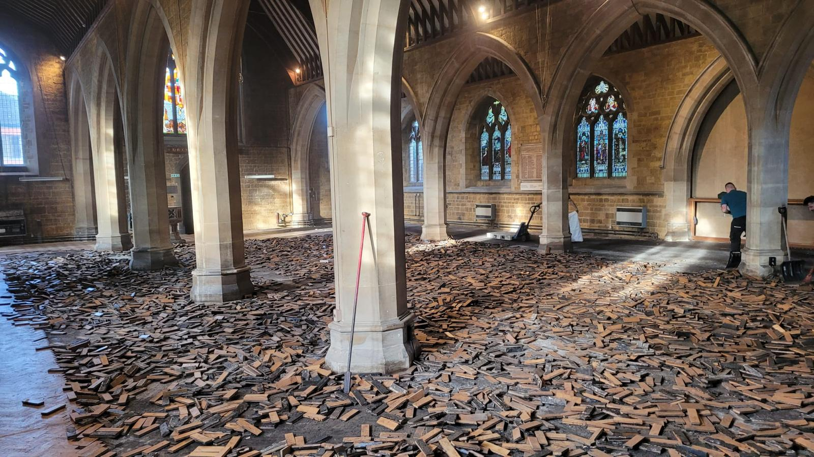
What have we here

Slide 13
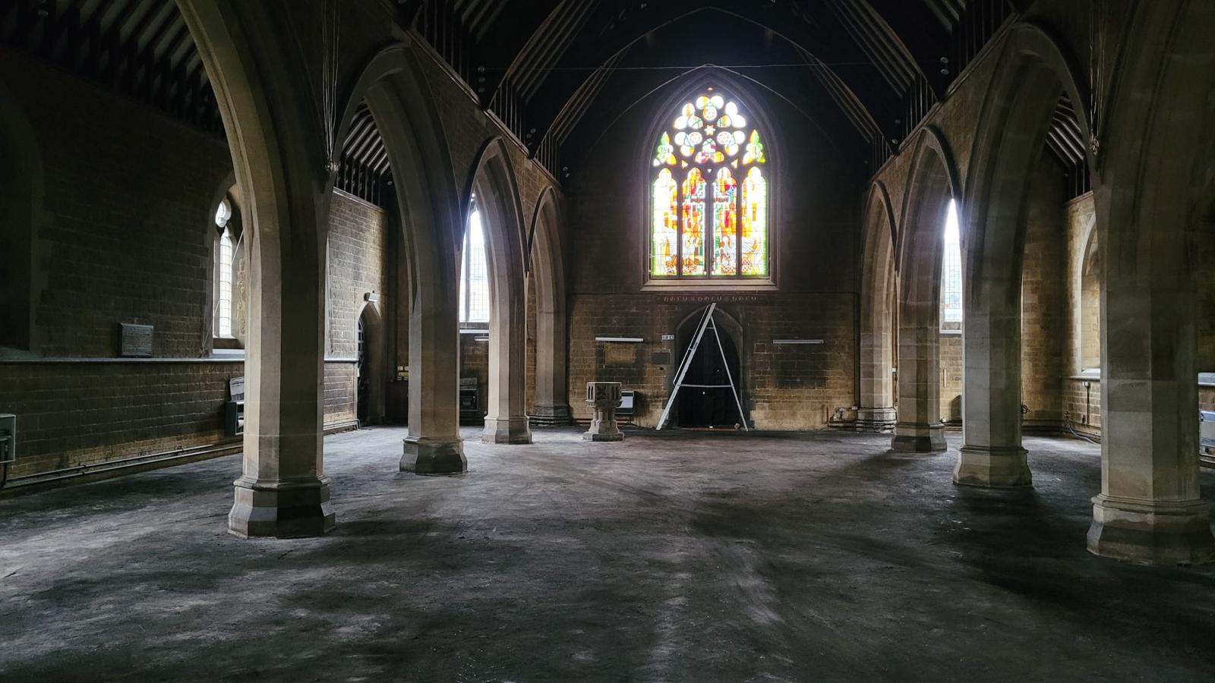
What have we here

Slide 14
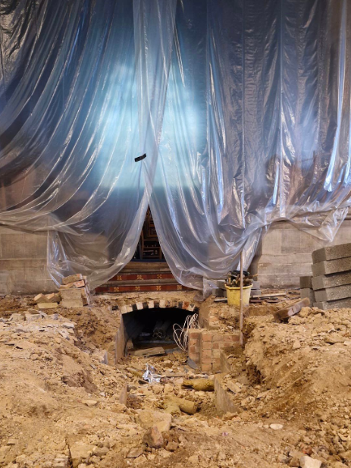
What have we here

Slide 15
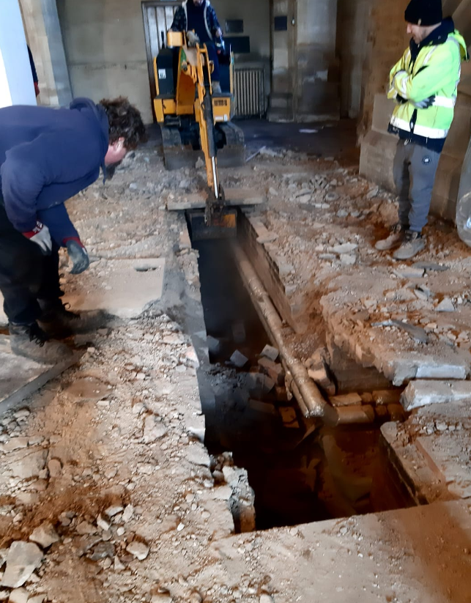
What have we here

Slide 16
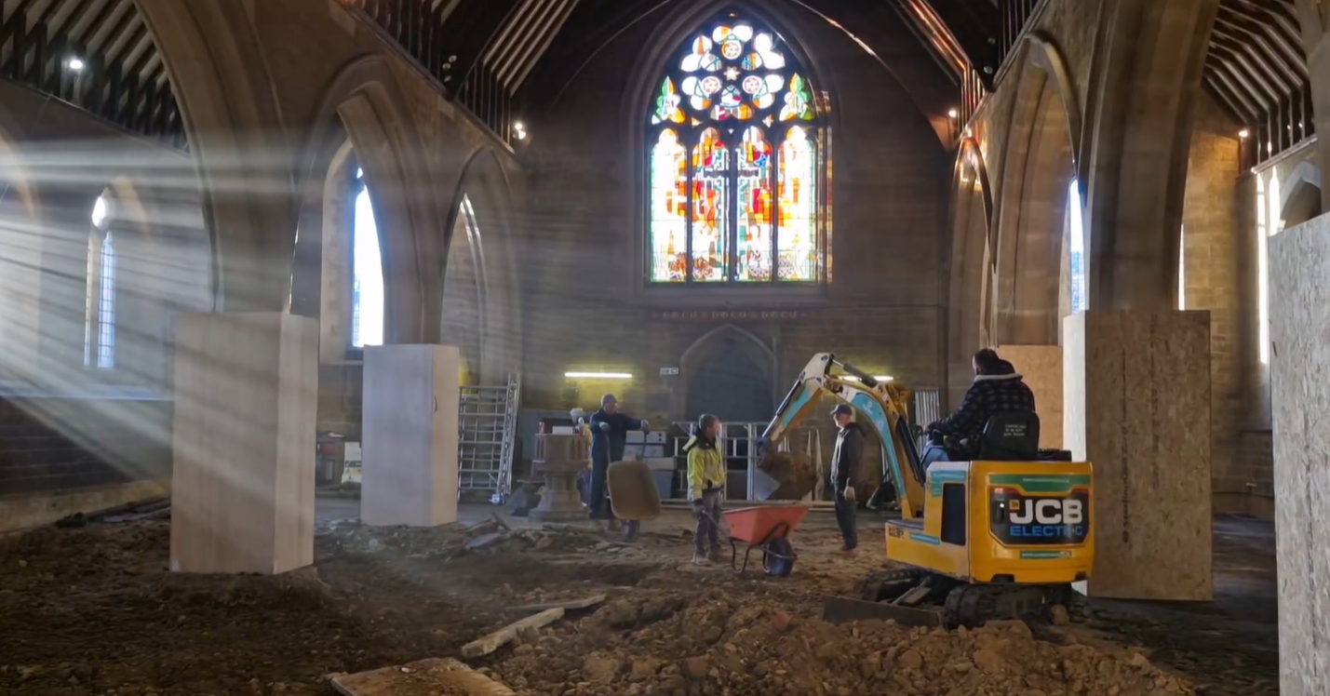
What have we here

Slide 17
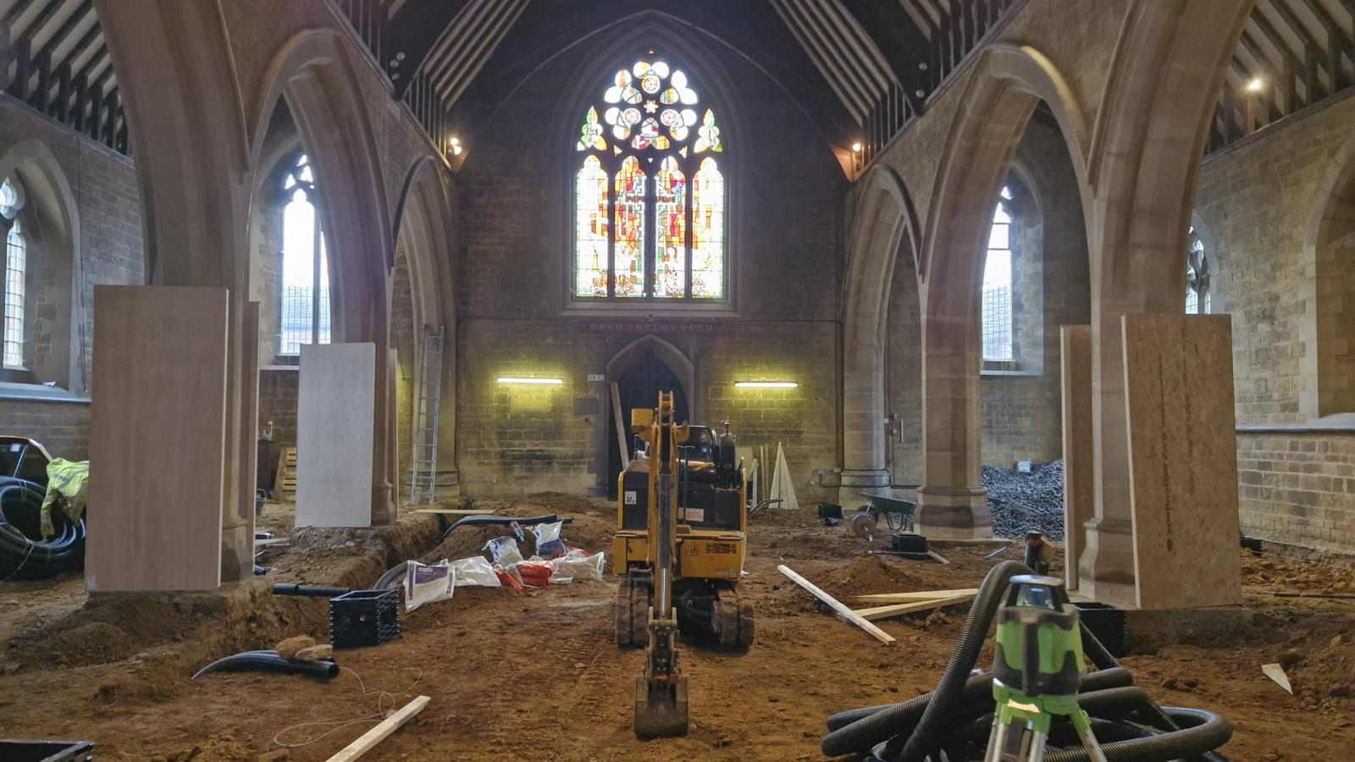
What have we here

Slide 18
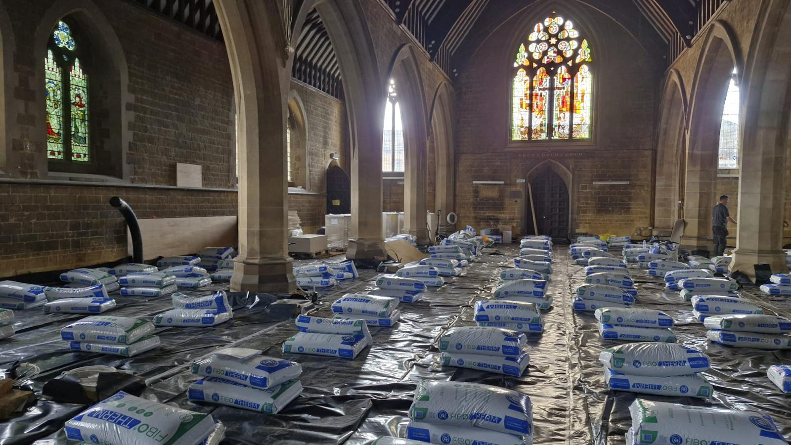
What have we here

Slide 19
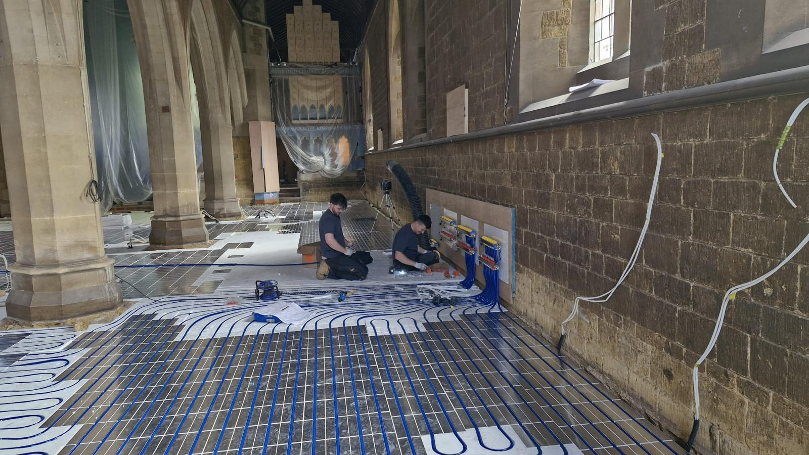
What have we here

Slide 20
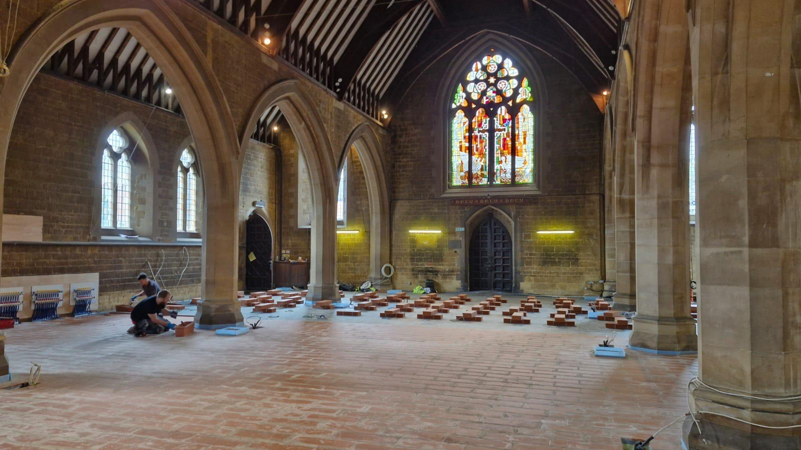
What have we here

Slide 21
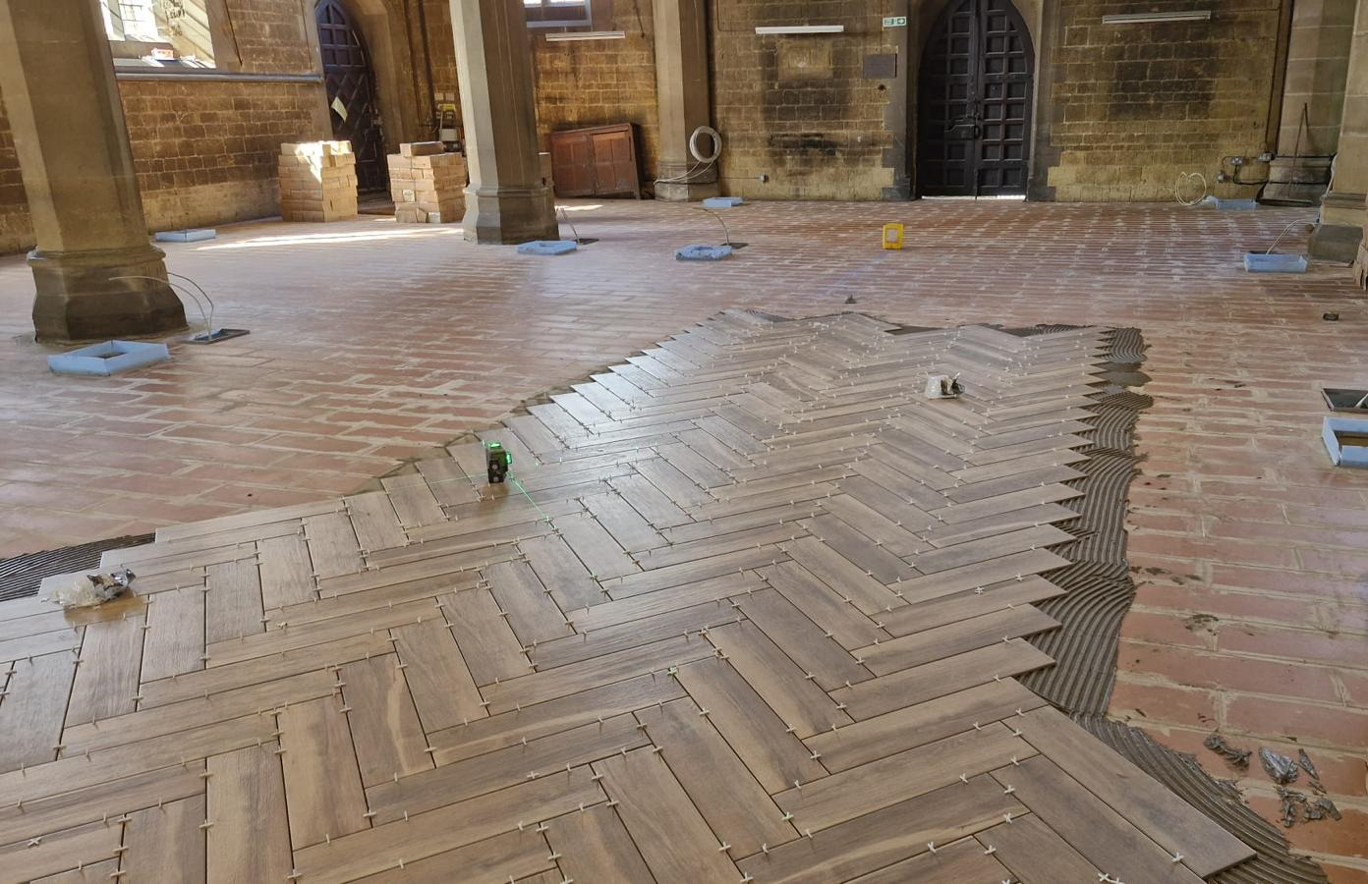
What have we here

Slide 22
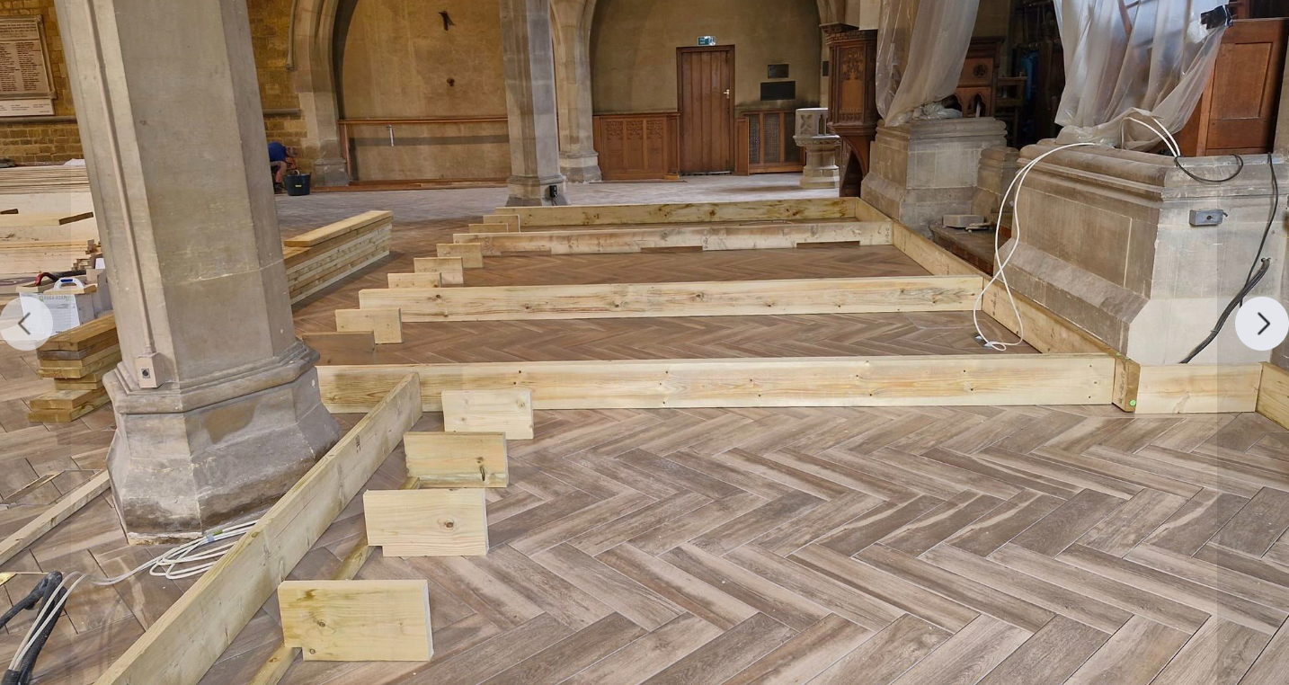
What have we here

Slide 23
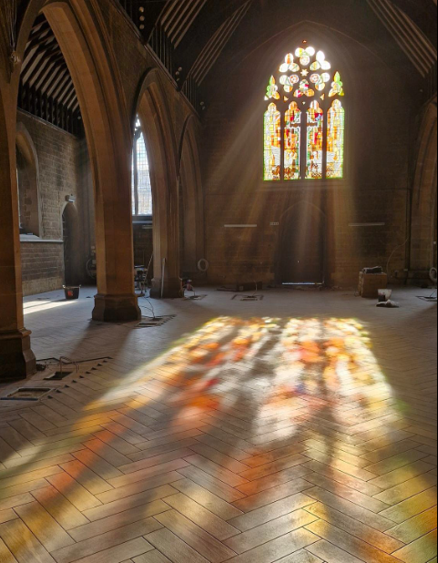
What have we here

Slide 24
Celebration weekend
20^{th,} 21st, 22nd September
Friday 20th evening – Civic Celebration
Saturday 21st daytime – family day fun day
Saturday 21st evening – Kettering Arts Centre event and launch of Kettering Comedy Club with return of Rev Nick Wills
Sunday 22nd 10am – Celebration Communion with the Bishop of Peterborough Right Reverend Deborah Sellin

Slide 25
Celebration weekend
20^{th,} 21st, 22nd September
The Friday event will be ticket only
All the Saturday and Sunday events are open to the public and you would be most welcome to join us

Slide 26
Thank you for listening
Now it is your turn
Any questions?

Slide 27
Thank you

