Slide 1
Natural-Ise Improving Bio-diversity along the River Ise in Kettering
What have we been doing?
2023-24

Slide 2
Google Earth image of area involved
Larger area of cut grass
Flower meadow established for over 15 years
New meadow developed over years

Slide 3
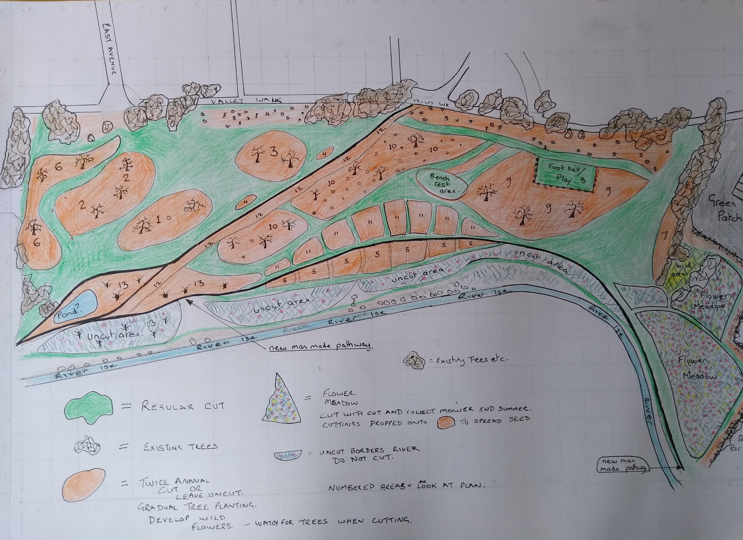
Big Valley Walk Plan for 2023
In 2022 Martin met the people from the council and agreed to draw up a plan to cut the 20 acres site differently.
For 50 years this site was cut every 2 weeks by the council but not many people walked through the middle of the field. Natural-Ise wanted to stop cutting some of it so that we could have more flowers for the insects and it would look nice for people.
Martin made the plan and the council agreed and work started in March 2023

Slide 4
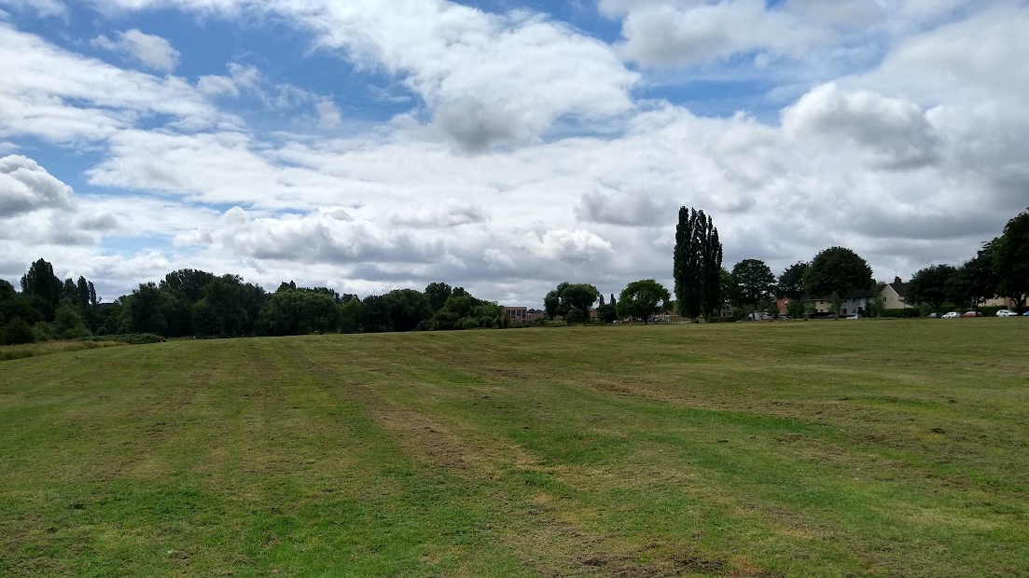
This is how the Valley Walk area started

Slide 6
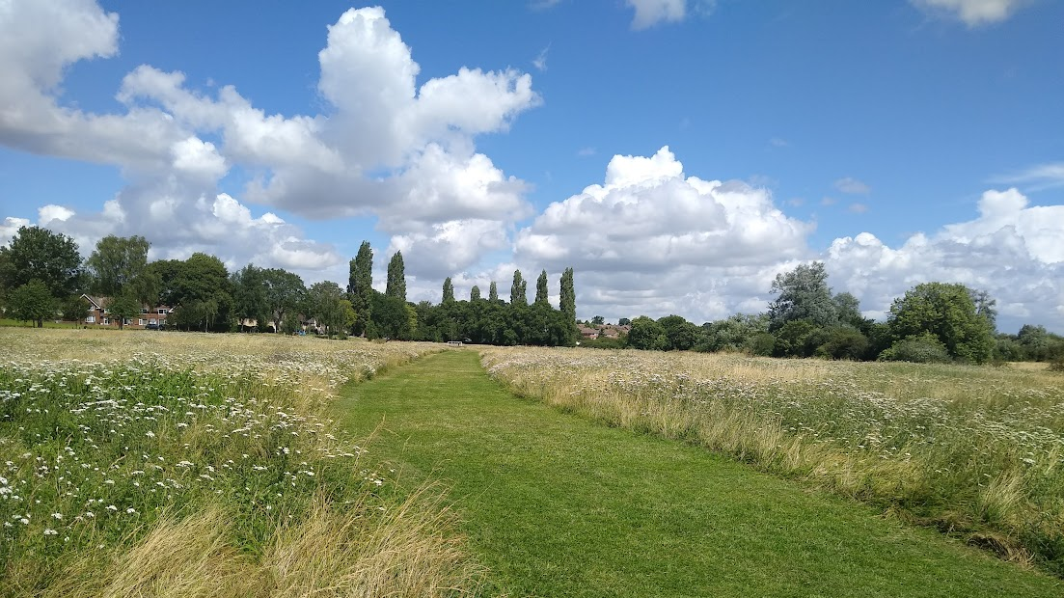
This is how the Valley Walk Area looked this year

Slide 7
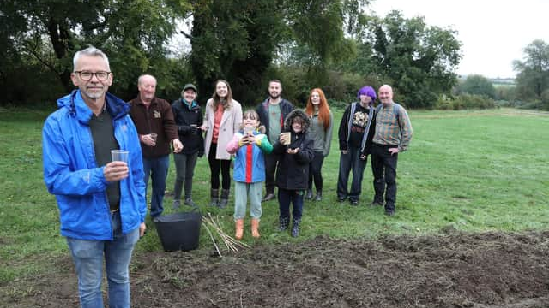
We mixed seed with 5x sand and through the seed onto the prepared ground.
The seed cost £1,000 and covered 2,500 square meters
Next year come down and see what it looks like

Slide 8
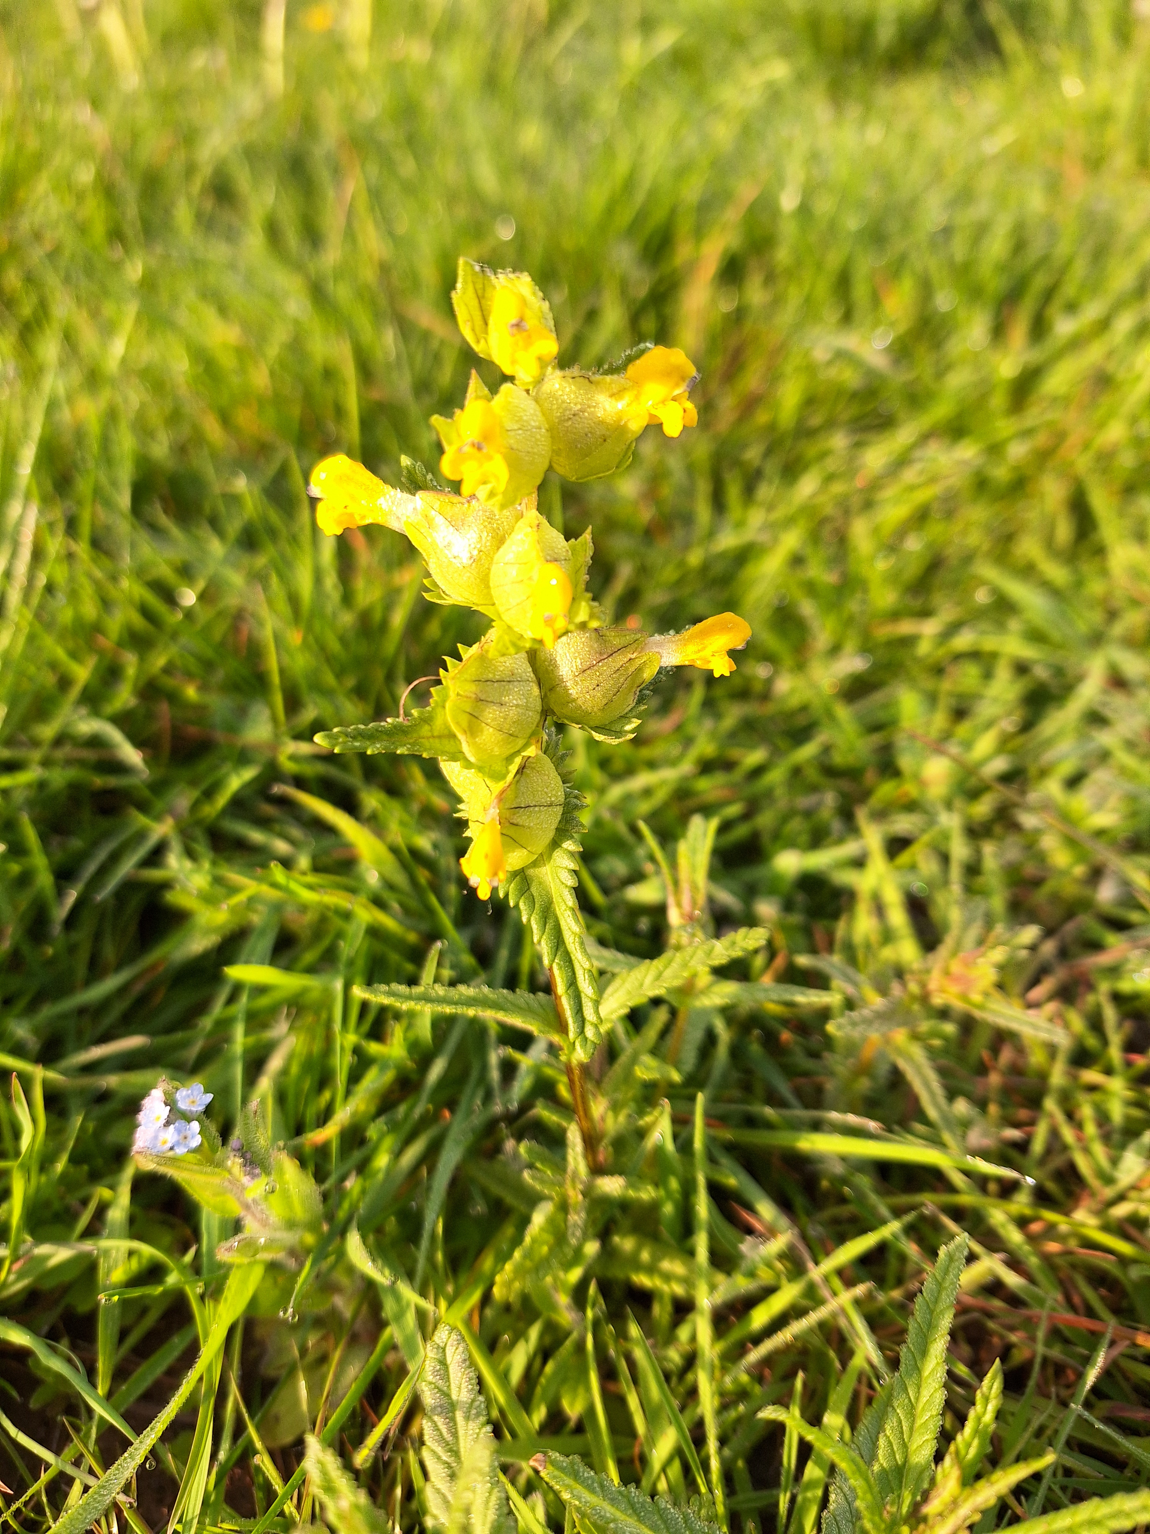
NATURAL-ISE –
New Baby
YELLOW RATTLE – from new seed
May 2024

Slide 9
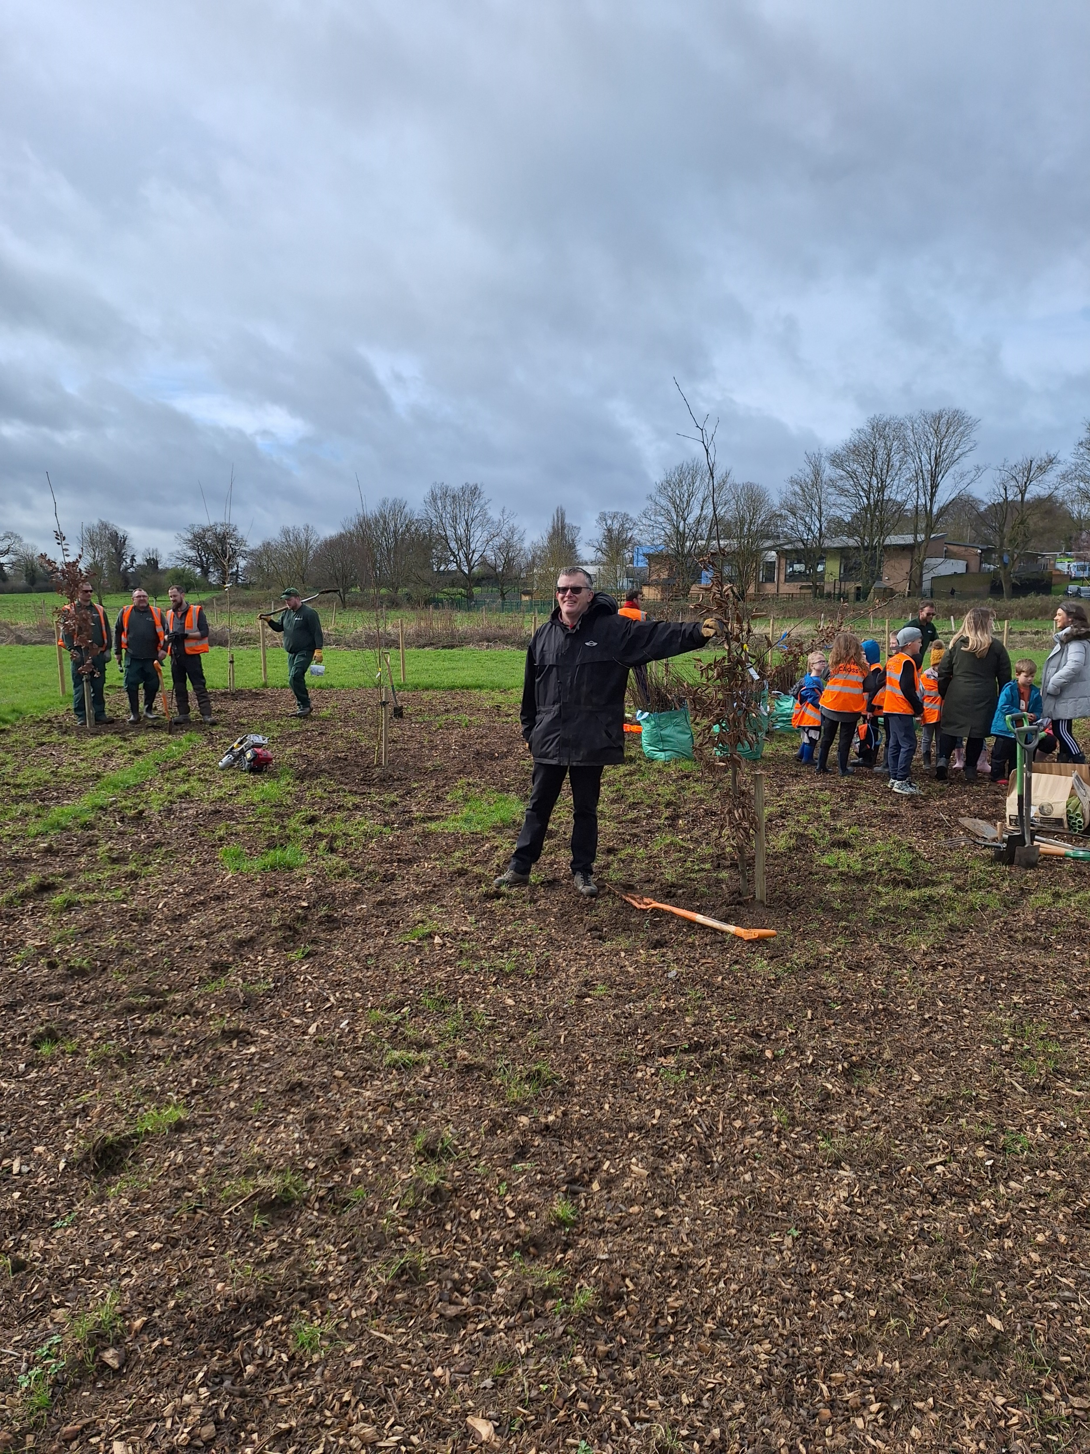
Tiny Forrest
750 trees in an area the size of a tennis court
By the Skate Park Grantown Close

Slide 10
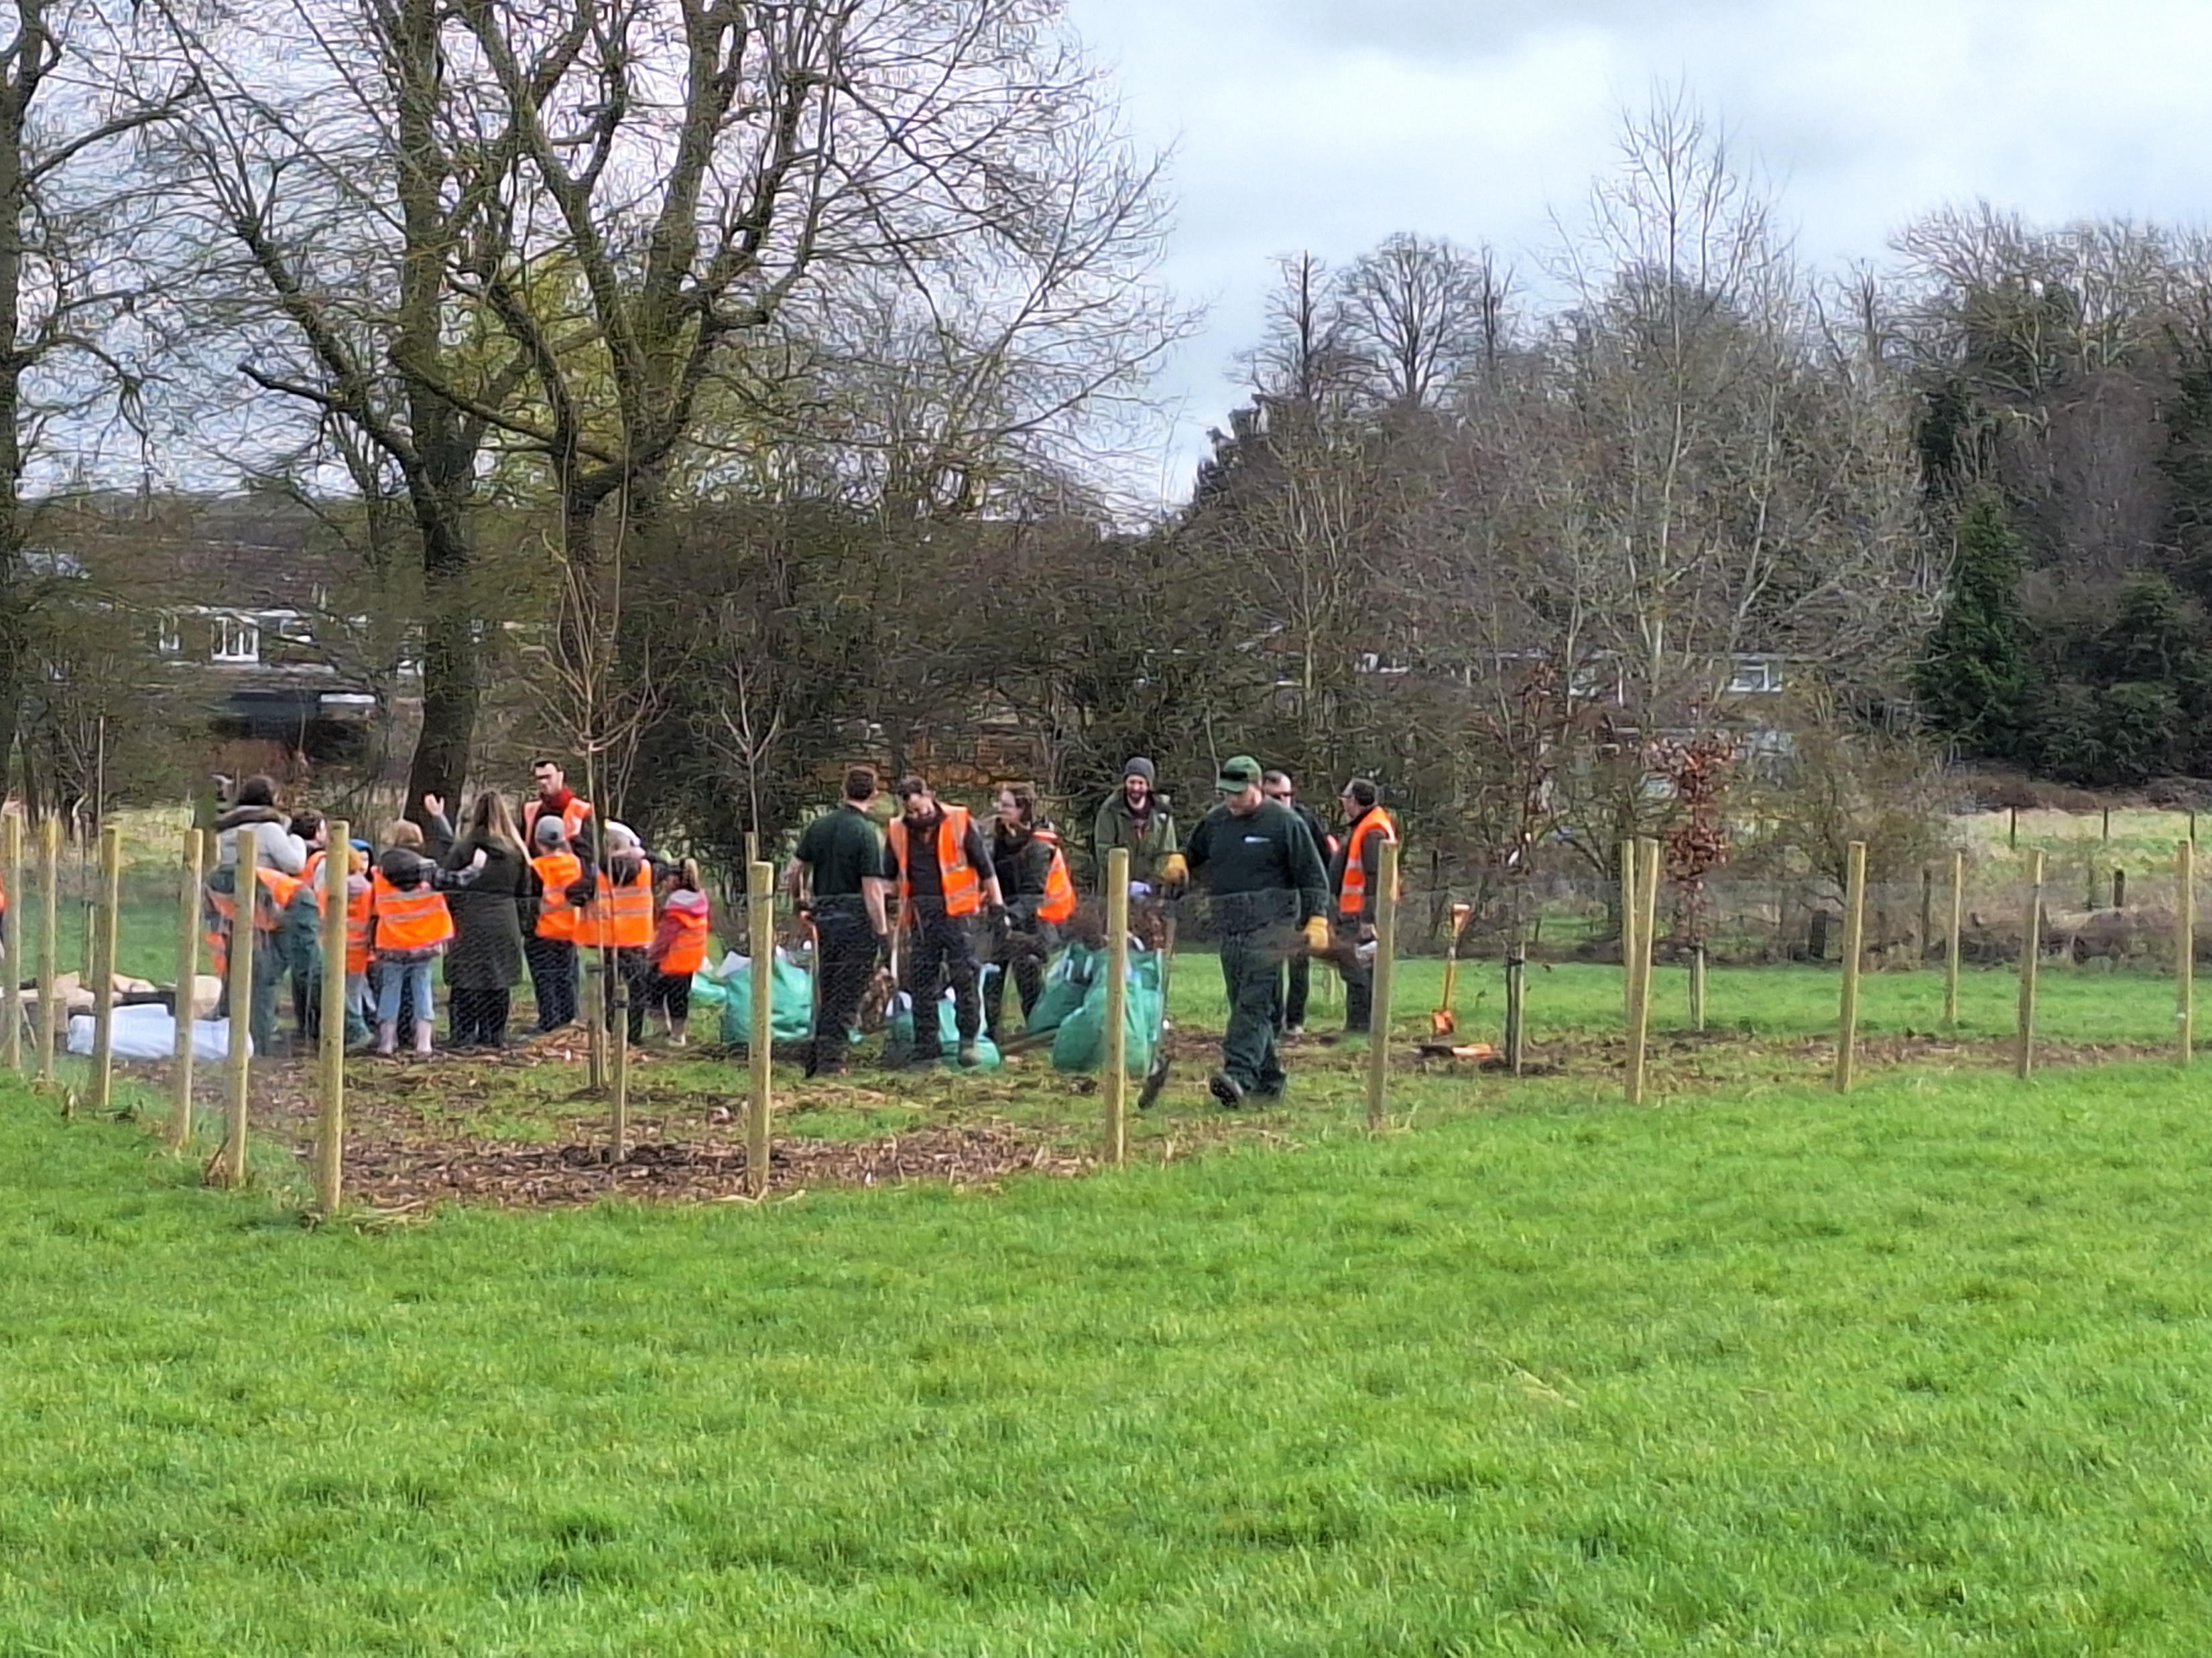
Help from pupils from Hanwood Park
Hayfield Cross

Slide 11
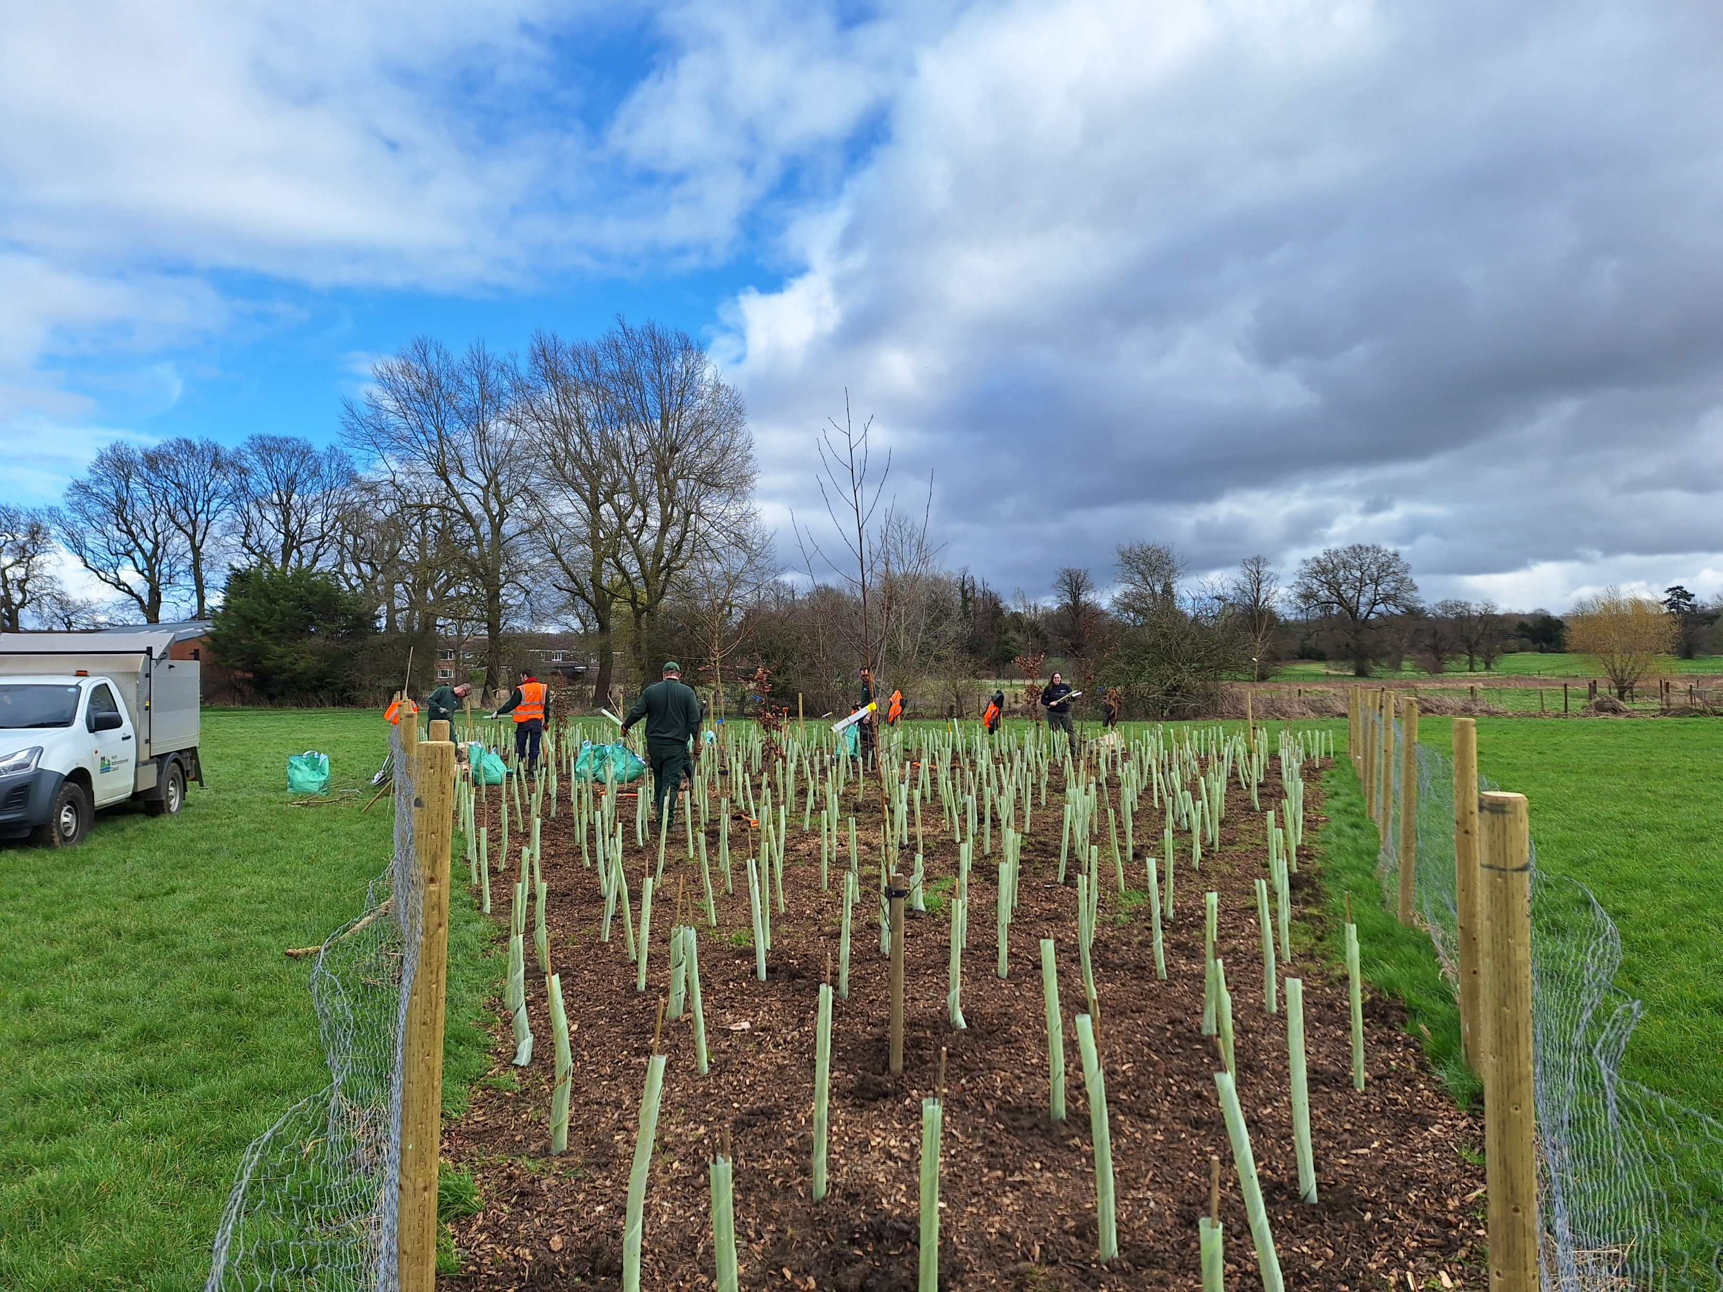

Slide 12
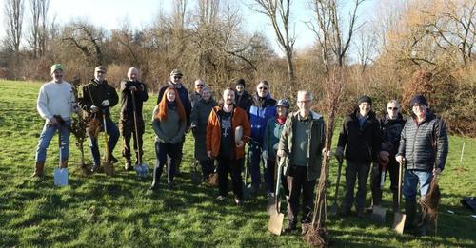
110 native British Trees planted on the Wobbly Field – Below Christ The King Church

Slide 13
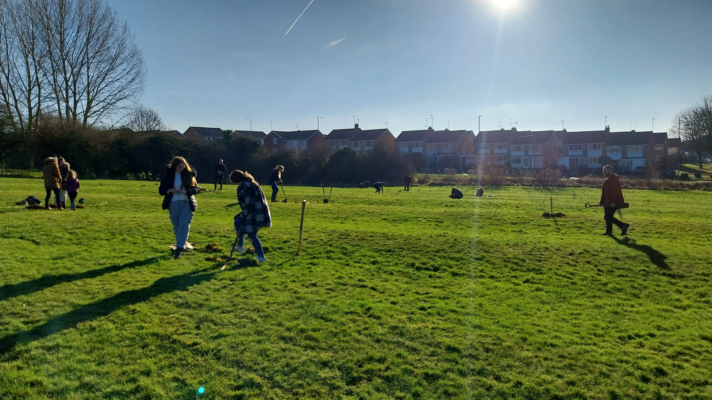

Slide 14
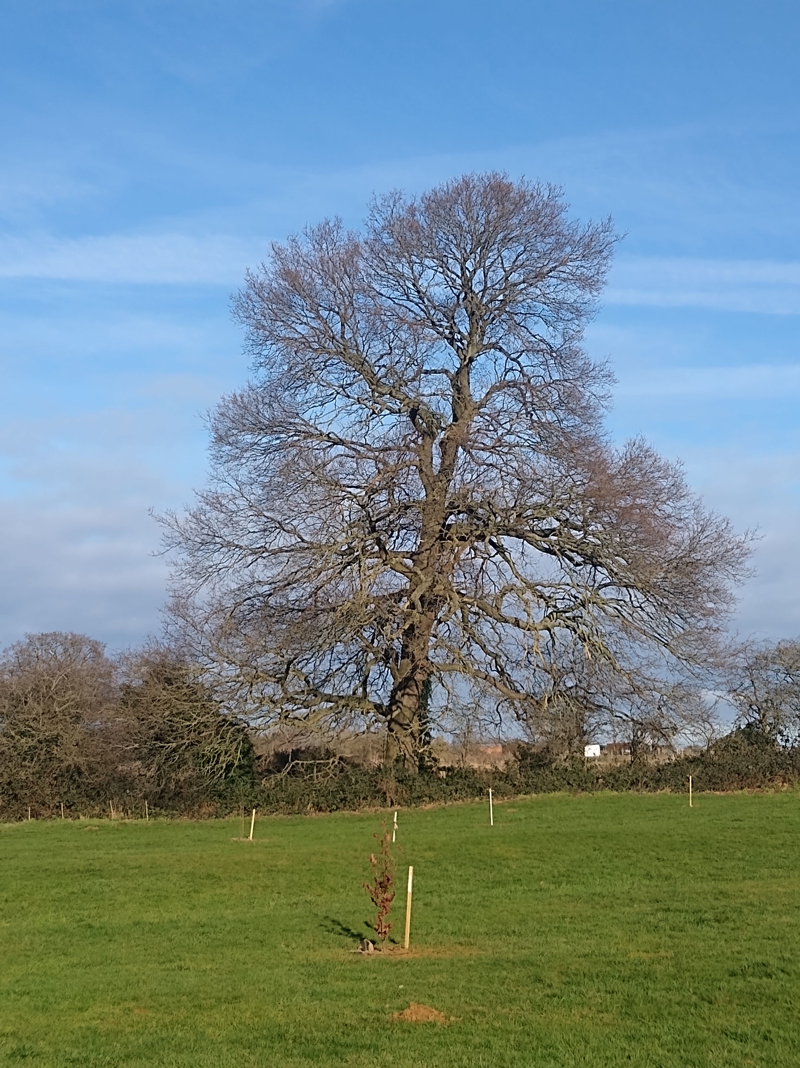
New trees set against the old oak tree
4m girth

Slide 15
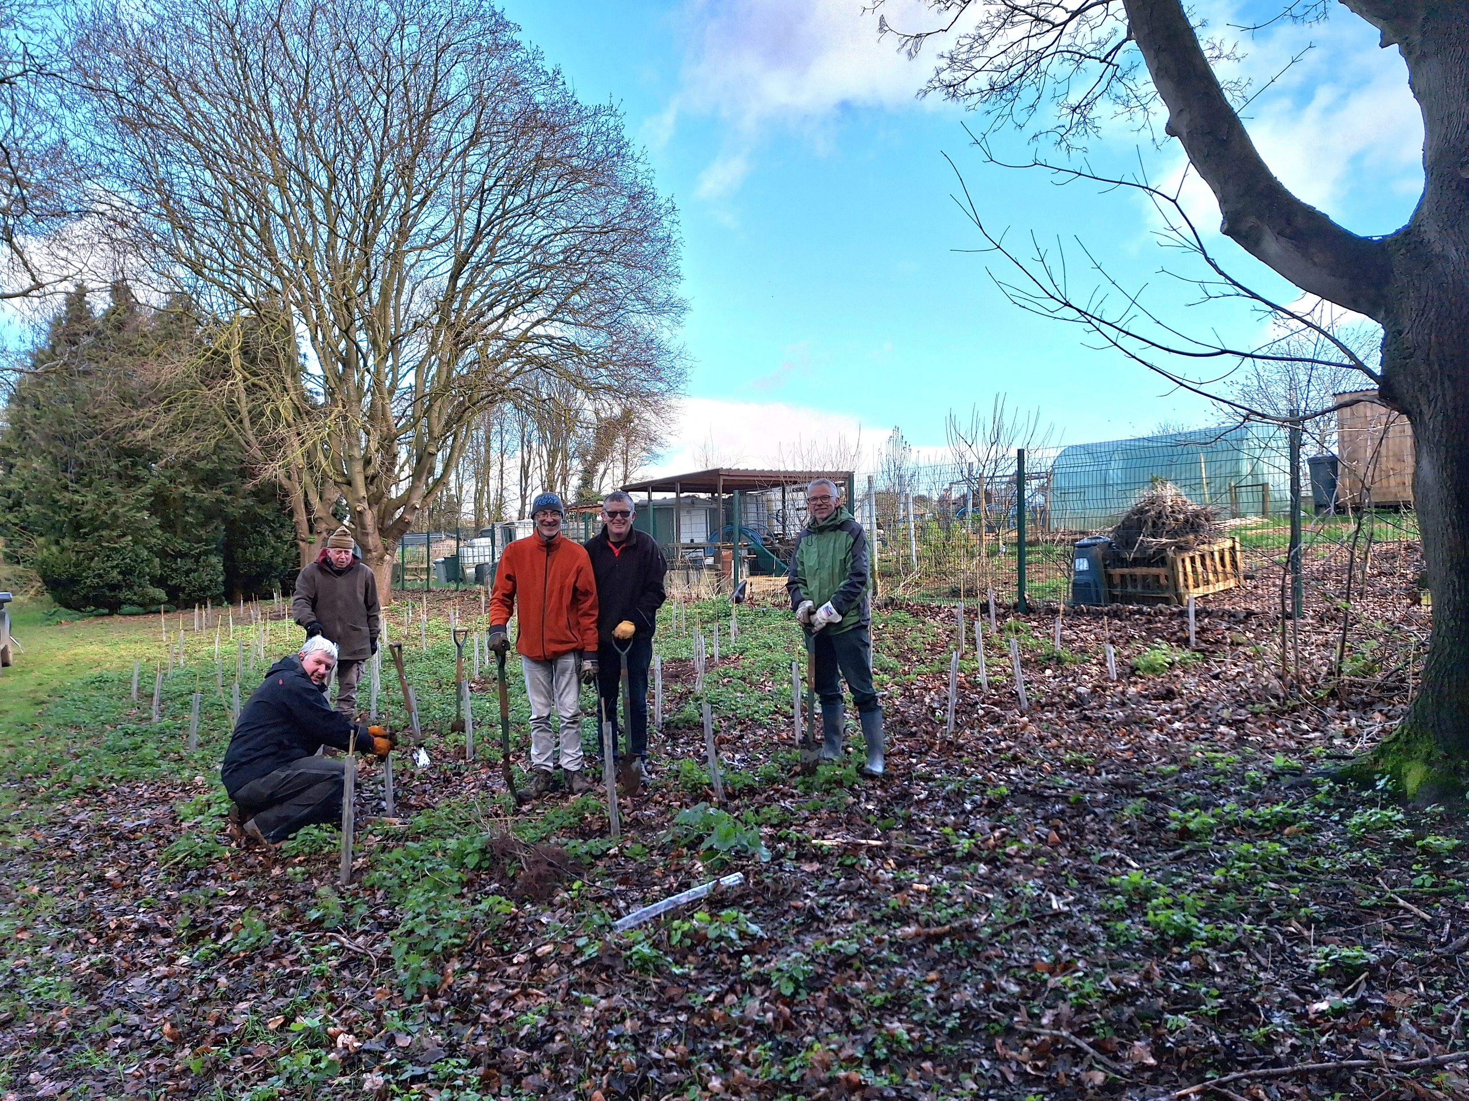
Helping Wicksteed Trust plant a hazel coppice

Slide 16
Where do we go next?
Maintenance of wildflower areas
Cutting
Bramble cutting
Maintenance of trees
Tying
Watering
Pond creation
Seed picking
Sowing more wildflower seed
Improving current areas
Strip on uncut area between Deeble Road and The Skate Park

Slide 17
Last but not least a quick word of thanks to:
All of our volunteers
NNC Grounds team
Councillors Paul Marks and Robin Carter for their Member Empowerment contribution

