Slide 1
Welcome!

Slide 2
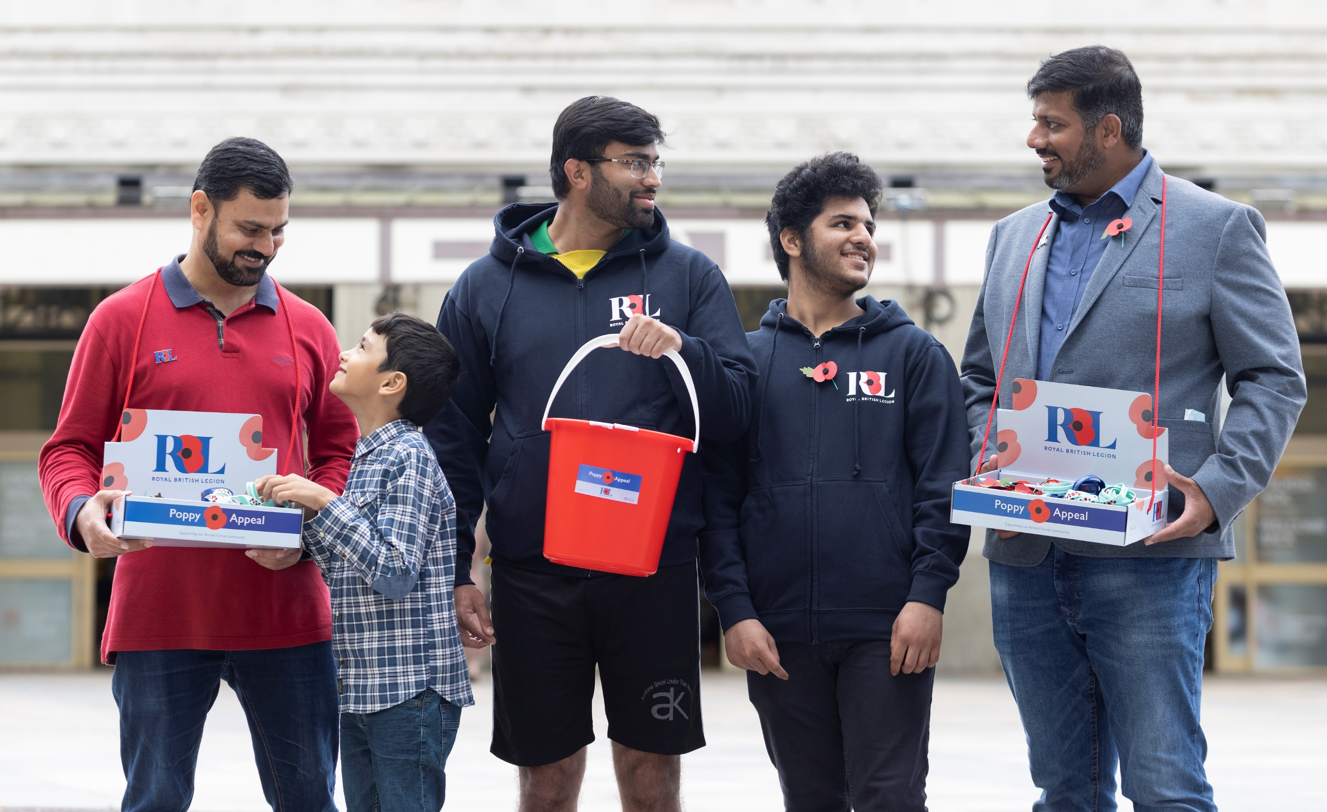
Current National Total: £38m YTD
Northamptonshire Total £512K YTD
Kettering Total: £34,031 YTD
Notes:
It was great to see so many social media posts from both the public and you, coming back together again with your volunteers and making poppies available to the Nation.
Do we have any information to add here from supermarkets, corporates etc…

Slide 3
The Impact of Our Services
Notes:
20/25 mins

Slide 4
The difference we make
“the Legion has earned my undying gratitude. I'd have been lost otherwise .”
“I can’t begin to tell you how much this will help me and my family. I’m currently laid in bed not wanting to get up as the house is so cold and my bones physically hurt with the cold. Tomorrow I can wake up with some heat on.”
“I Never thought that I would have to ask the R.BL for help, bean a member since i left the army in 1971 . 49 years a standard bearer, poppy seller now i had to ask for help, NOW I REALISE THE WORK YOU DO IS PRICELESS”
“The help you have given me is a god send. I can’t thank you enough. I will stay warm this winter, And be able to eat properly.”
“The work that you’re doing during these unprecedented times is absolutely incredible. You are helping people to survive, get through hard times and I personally can’t thank you enough! Well done team RBL! X”
“I can’t begin to tell you how much this will help me and my family. I’m currently laid in bed not wanting to get up as the house is so cold and my bones physically hurt with the cold. Tomorrow I can wake up with some heat on.”
“ABSOLUTE live savers I would be in a very bad place if it had not been for RBL and the fantastic help they provide “
Notes:
Beneficiary quote: (removed from slide – but still worth speaking about)

Slide 5
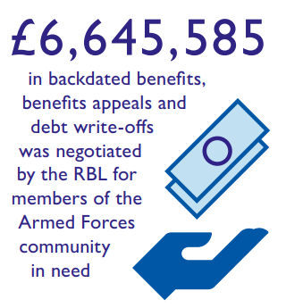
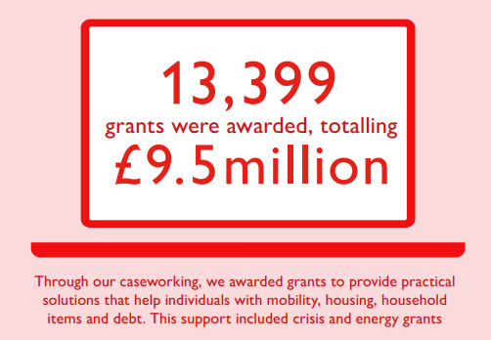
Casework and Specialist Advice
90% Customer Satisfaction
88% Needs Met
Over 5000 applications for cost of Living support
Estimate £12m this year
Expenditure £22.3m
~250 Expert Staff
Financial Conduct Authority, ICO and Charity Commission Regulation

Slide 6
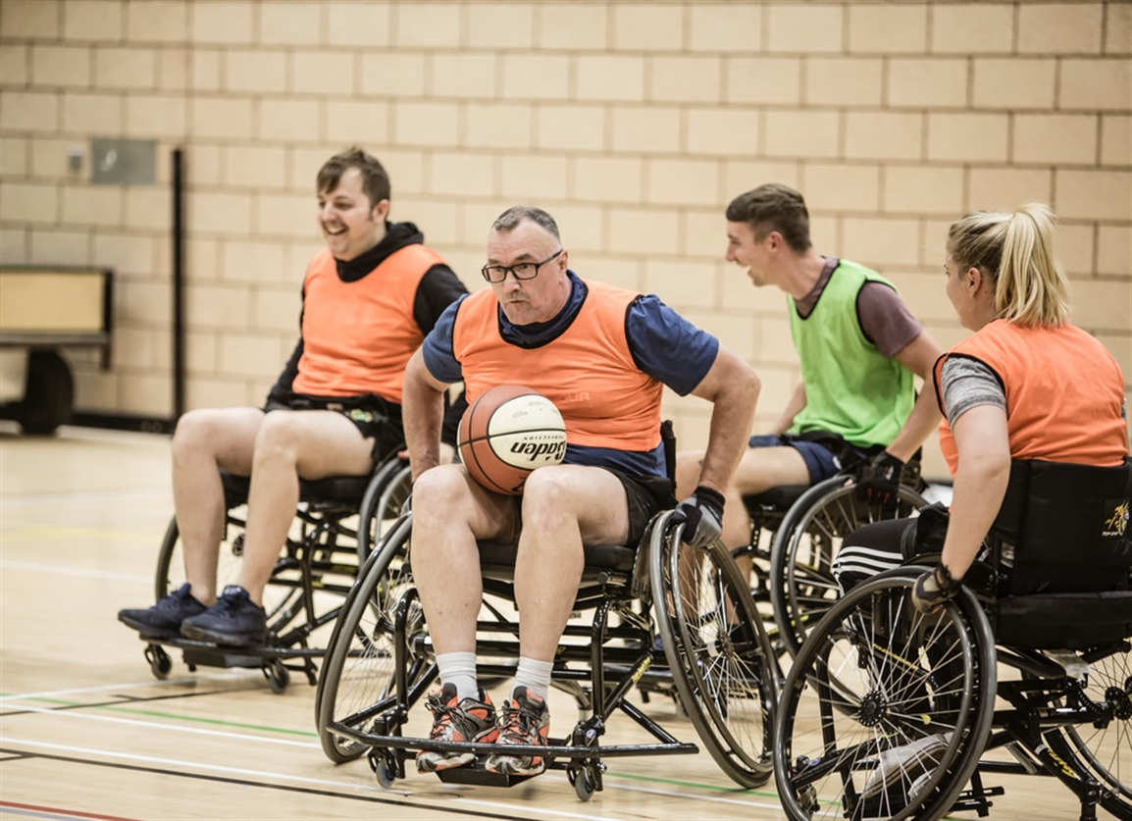
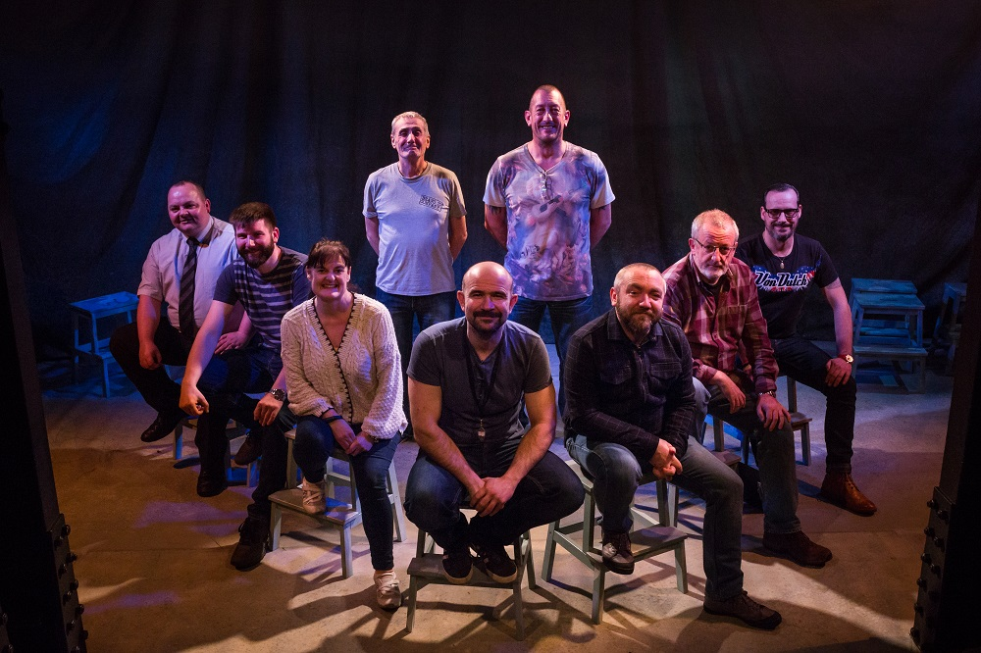
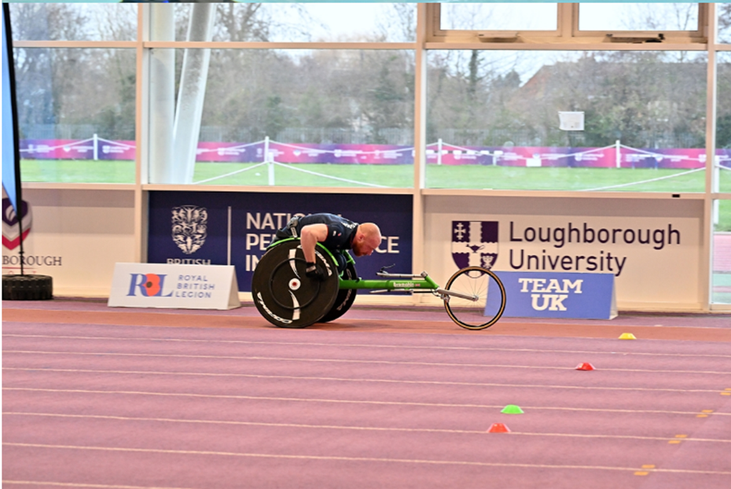
Battleback
£4.5m
Over 1500 people supported
Evidence based impact
Recovery
Arts and Media
Invictus Team UK and more

Slide 7
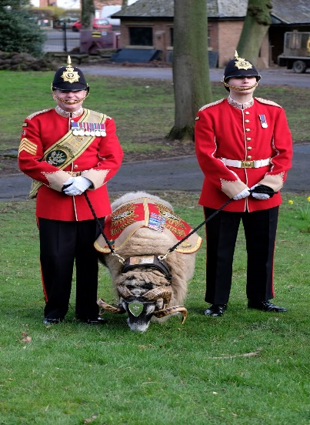
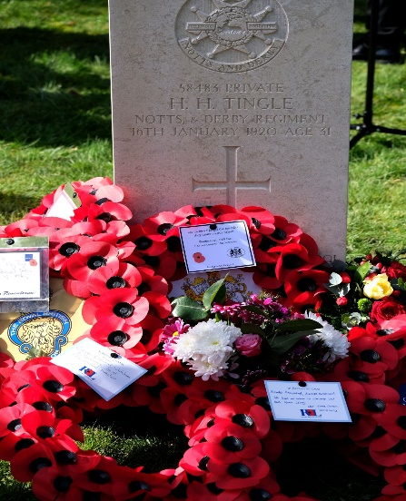
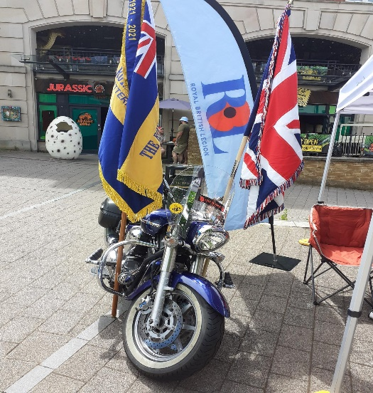
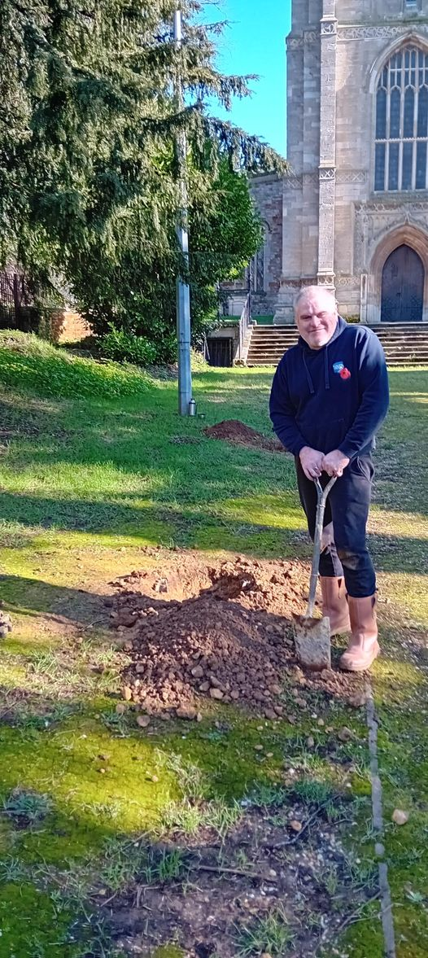
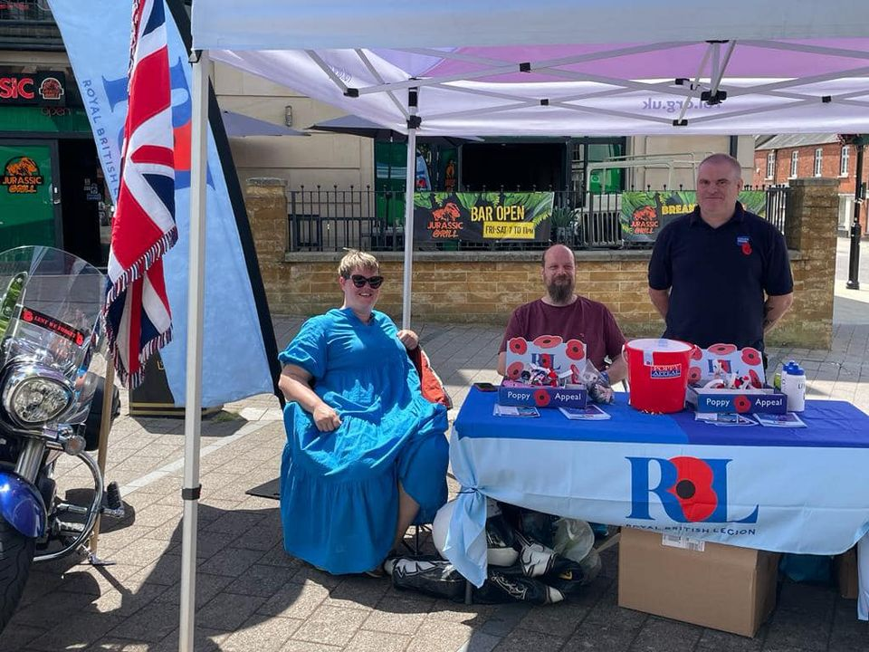
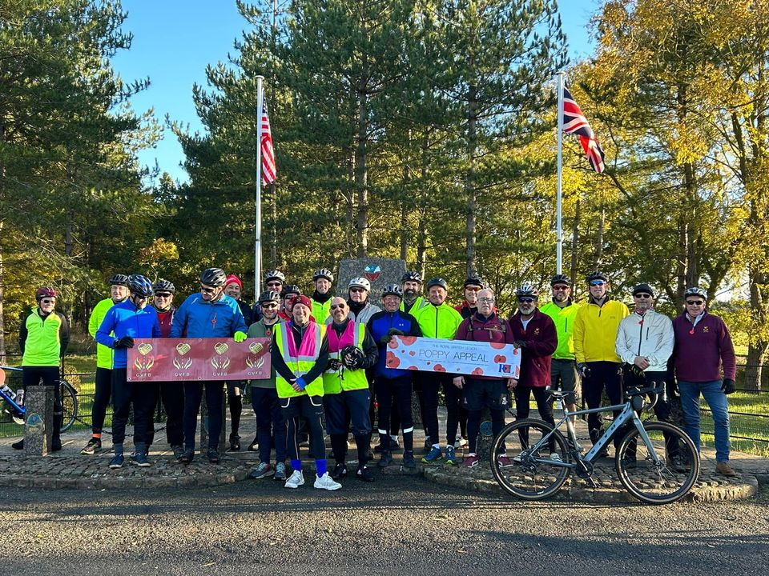
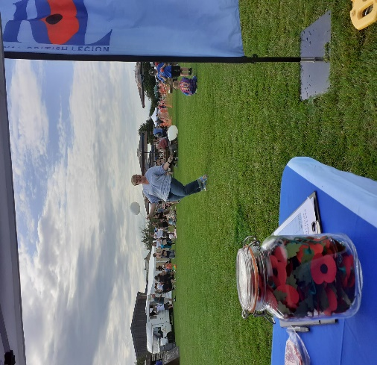
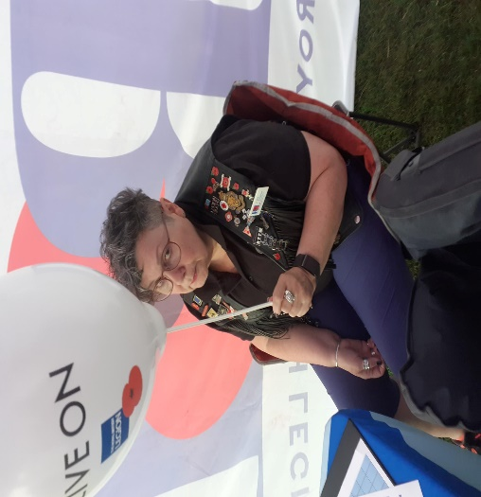
Kettering Branch
Notes:
Giles to add images from county

Slide 8
Vision For 2024
Increase Our Community Engagement & Profile
Work In Partnership With Kettering Community Groups
Ongoing Assistance To Any Serving Or Ex-Service Personnel
Create An Environment That Fosters Comradeship For All
Ensure Public Awareness Of Remembrance Throughout The Year
Representation And Advocation For The Armed Forces Community.

Slide 9
Questions?

