Slide 1
Kettering complementary Therapy Group

Slide 3
Autumn Plans
Newlands Centre
Health and information windows
Health and information hub and possibly Taster sessions through October supporting Cransley hospice
RushdenLakes
Taster sessions on Friday October 11th-Supporting Cransley hospice
Christmas Fayres information and fund raising at
All Saints Church 23rd November & St Andrews Church 5th & 7th December

Slide 4
Talks & Taster sessions available to any groups
How holistic complementary therapies can help
From Aromatherapy to Indian head massage and Reflexology
How to cope with problems such as Stress ,Sleep Menopause Pain IBS
Self help therapies
Try Ear reflexology

Slide 5
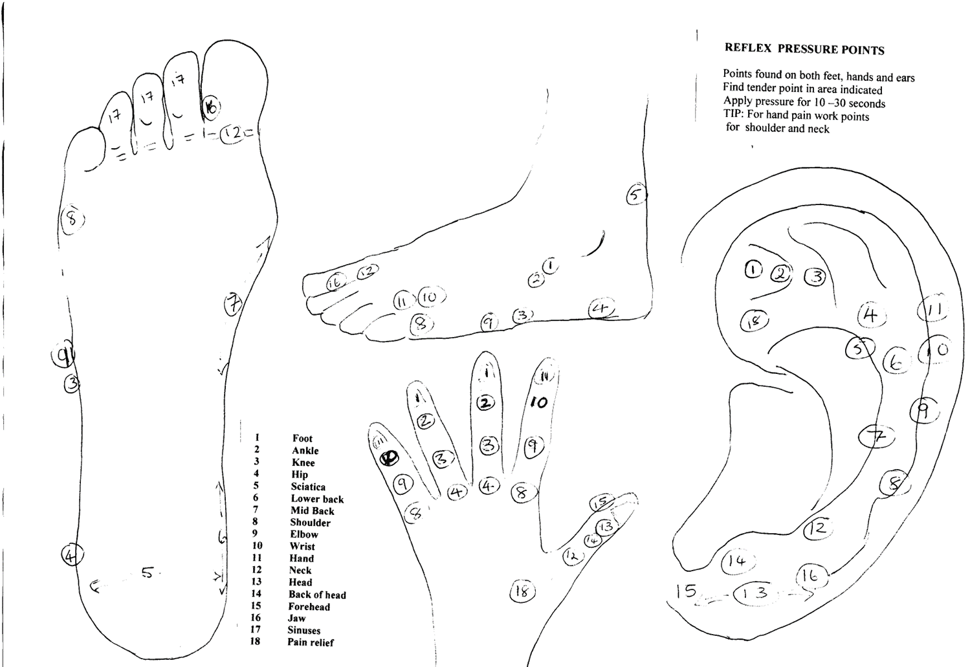

Slide 6
Kctg monthly meeting
talks & workshops
15th August Living proactively ( how to calm your bully brin )
Lorraine Mitchell
19th September BEMER Therapy Edina
17th October Edina Buteyko Breathing
November 21st ’how to survive the winter with
complementary therapies ’ Barb
December care and share last minute relaxation session

