Slide 1
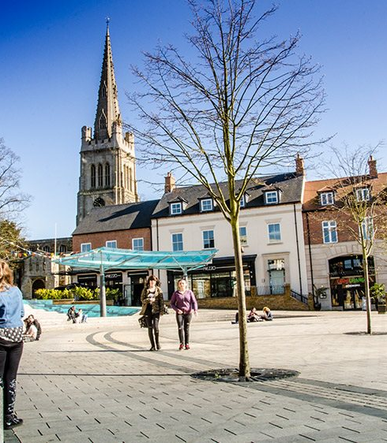
Kettering Town Council Activity and Finances
Kettering Town Meeting
Wednesday 22 May 2024

Slide 2
Policies and Priorities
Economy
Growth
Town centres
Sustainability
Climate change mitigation
Development standards and policies
Biodiversity
Walking, cycling and public transport
Organisational effectiveness
Public Stewardship
Communications and engagement
Respect and partnership working
Sustainable Office
Health and wellbeing
Safety
Wellbeing
Armed Forces Covenant

Slide 3
What We Do
Markets
Events
Allotments
Grants
Town Lottery
Planning
Neighbourhood Planning
Responding on planning applications
Supporting local communities
Climate change & biodiversity
Community/road safety
Managing local charities
Fuel grants
Support to students
Mayoralty
Lobbying and influencing

Slide 4
Our Budget this year (24/5)
£490,000 precept
£29 per band D household
55p a week on average
Income from activities £33,000
Markets and events
Allotments
Town Lottery
Interest on accounts
Major items of spend
Events £ 115,000
Christmas Lights £ 40,000
Public toilet project £ 100,000
Grants £ 40,000
Hanging baskets etc £ 28,000
Employees £ 101,000

Slide 5
Our resources
Our members
20 councillors
Staff
Three office staff - 2.2 FTE
Market superintendent
Casual staff employed on markets and events and to support Mayor
Land and property
Allotments
Mayoral insignia, robes, mayoral collection
Markets stalls and equipment
Equipment to support events
Speed devices
Reserves
Public toilets fund £100,000
Elections fund £ 36,500
General reserves £ 93,500

Slide 6
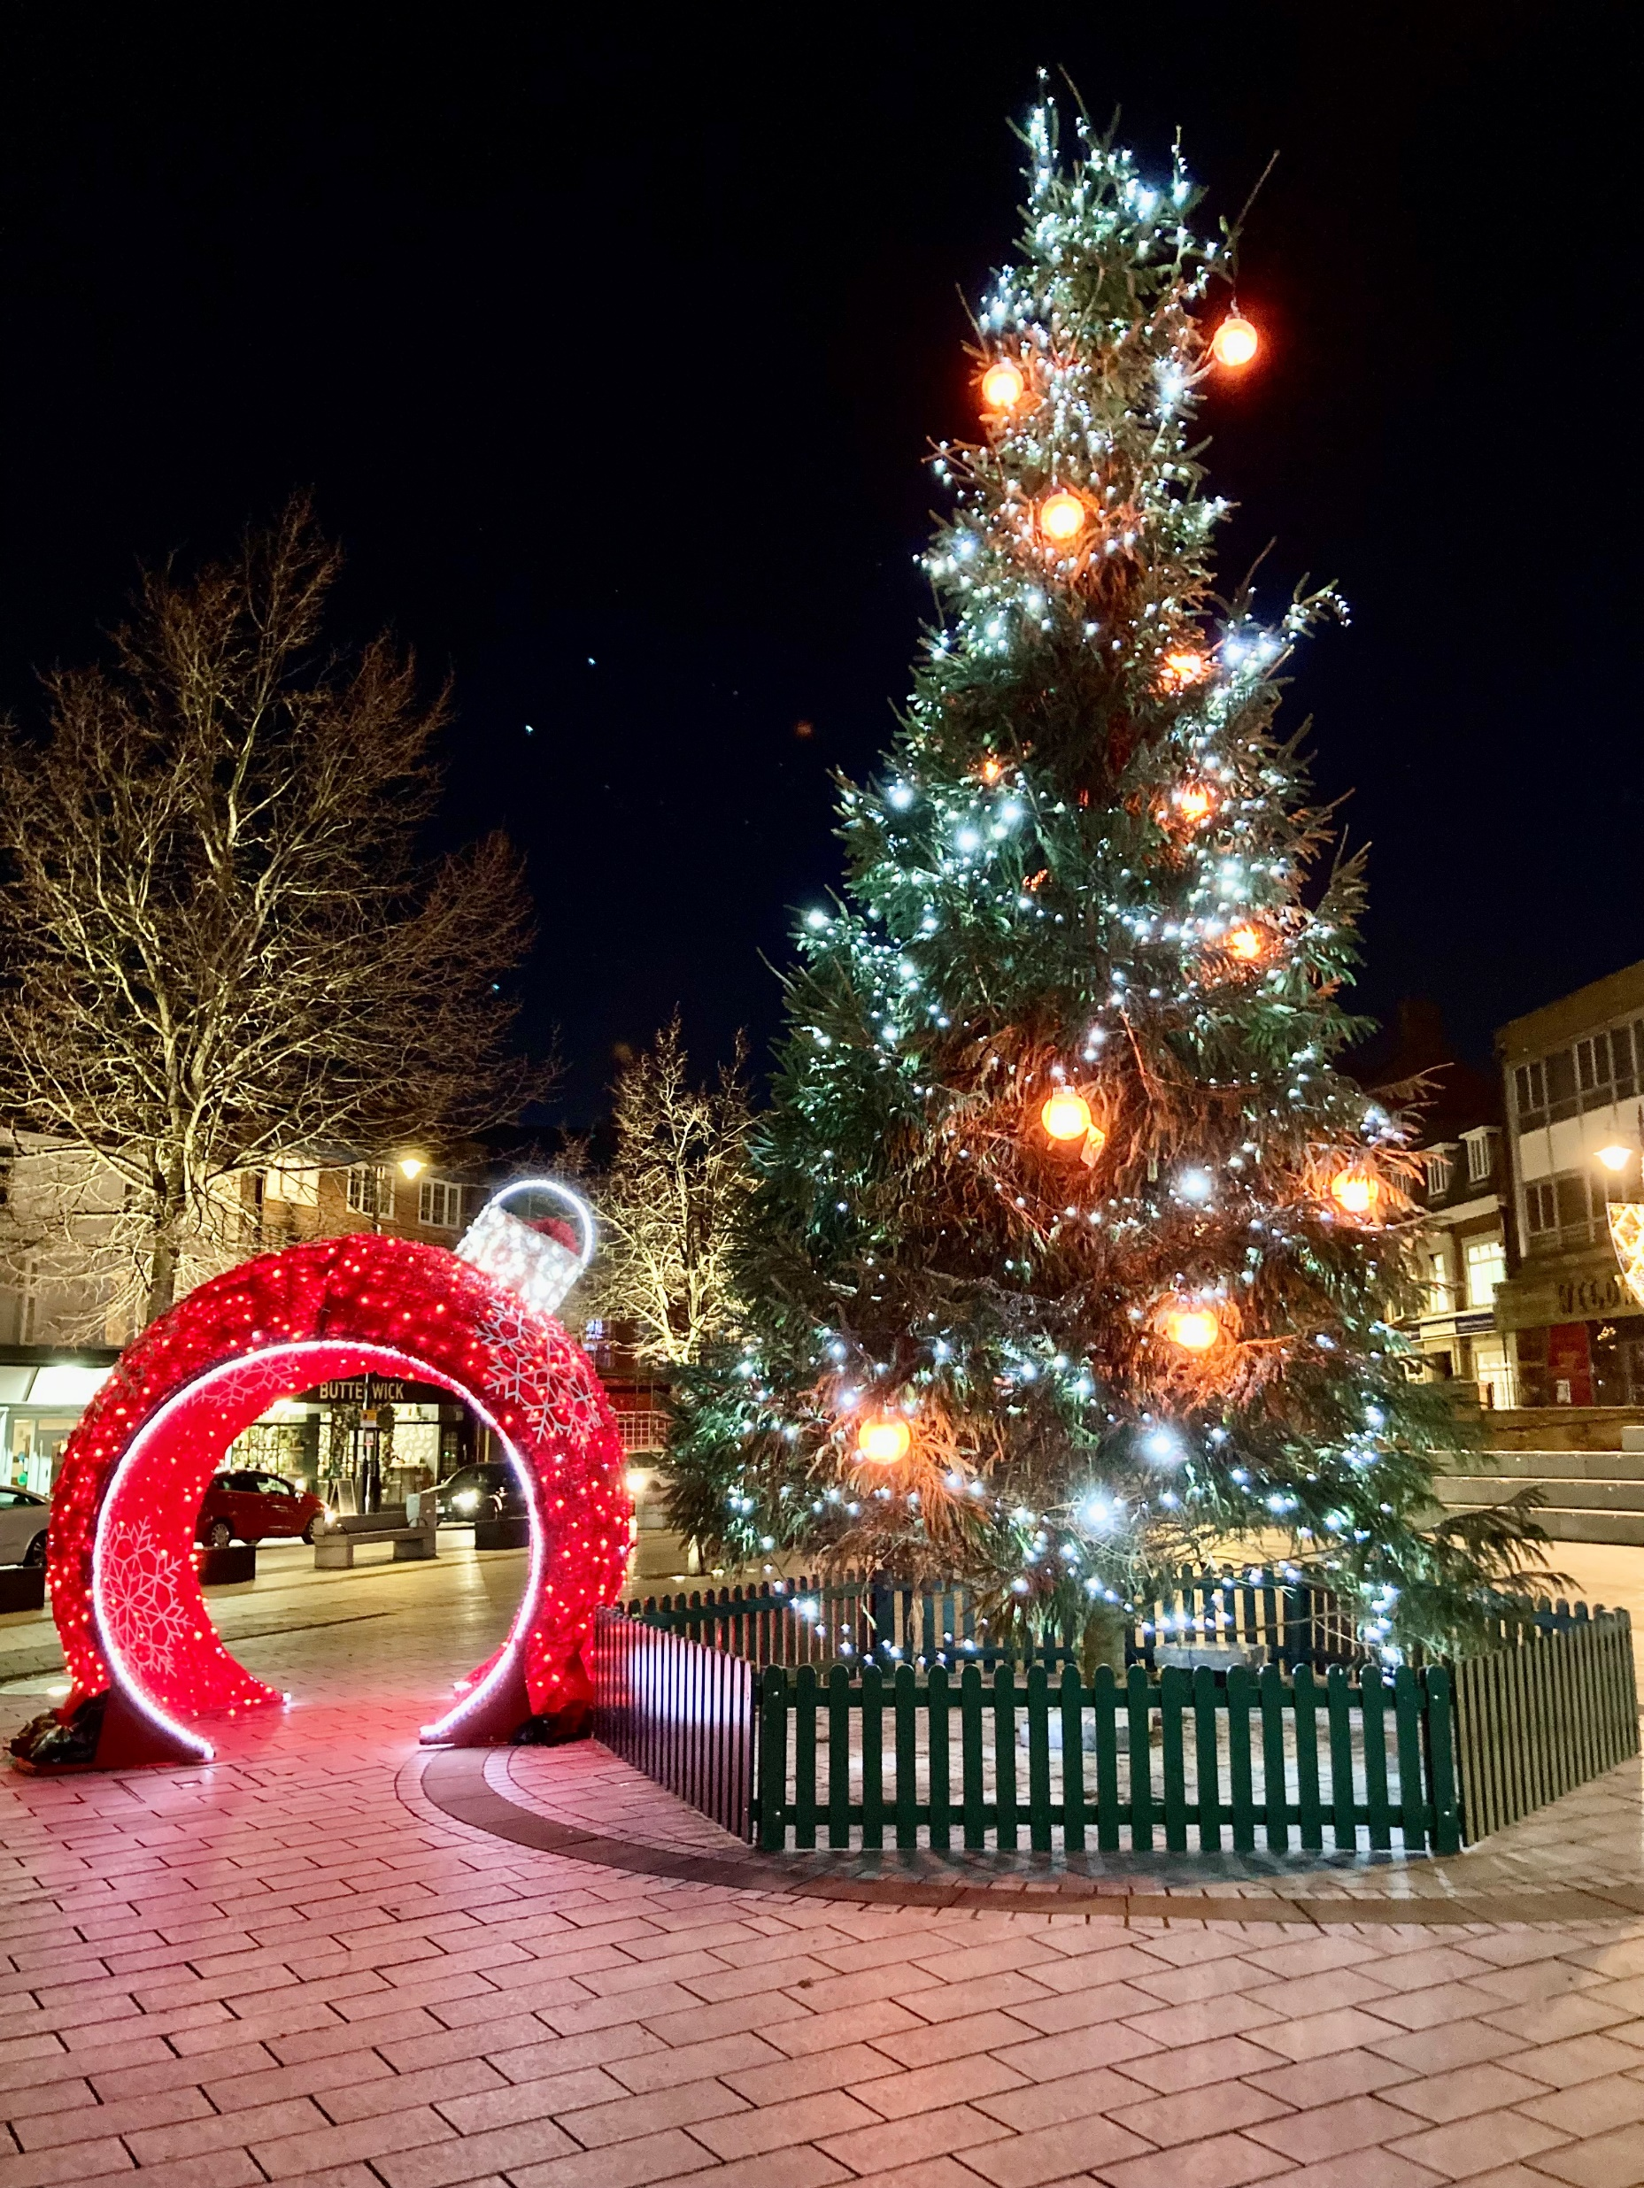
Key achievements in 2023-4 (1)
Providing the town’s Christmas lights
Expansion of events programme
New community infrastructure
Speed devices
Bleed kits
Improving allotment sites
Fencing at Windmill Ave
Margaret Rd asbestos

Slide 7
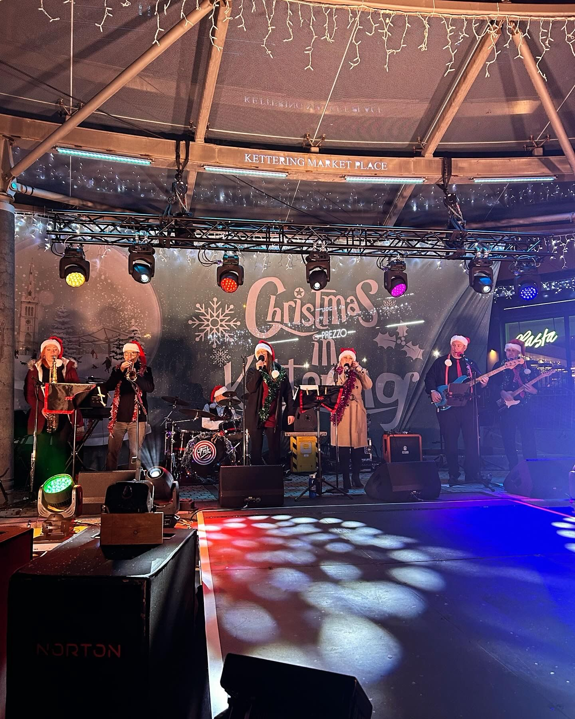
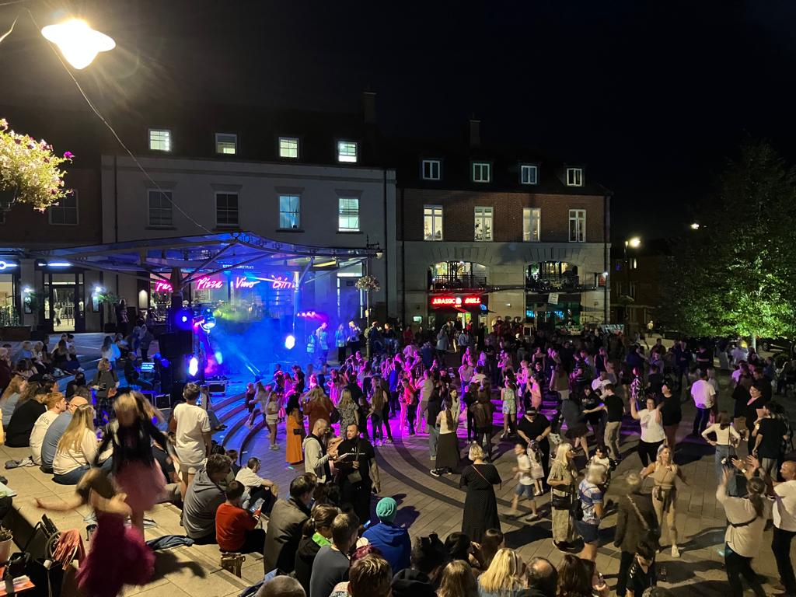
New Events in 2023 Kettering by the Sea Friday night discos Christmas lights switch on Love Food at Wicksteed Park Midsummer market for the voluntary sector Skateboarding tuition sessions

Slide 8
Key Achievements in 2023-24(2)
Grants for voluntary and community sector
Temporary support for Shopmobility
Love Wildlife Grants
Representing local people
Mental Health Awareness
Access to Newland St
Responding on planning and licensing issues
Improving the general market
Neighbourhood Plan for the Headlands Area adopted April 2023.
New Kettering Cultural Consortium established

Slide 9
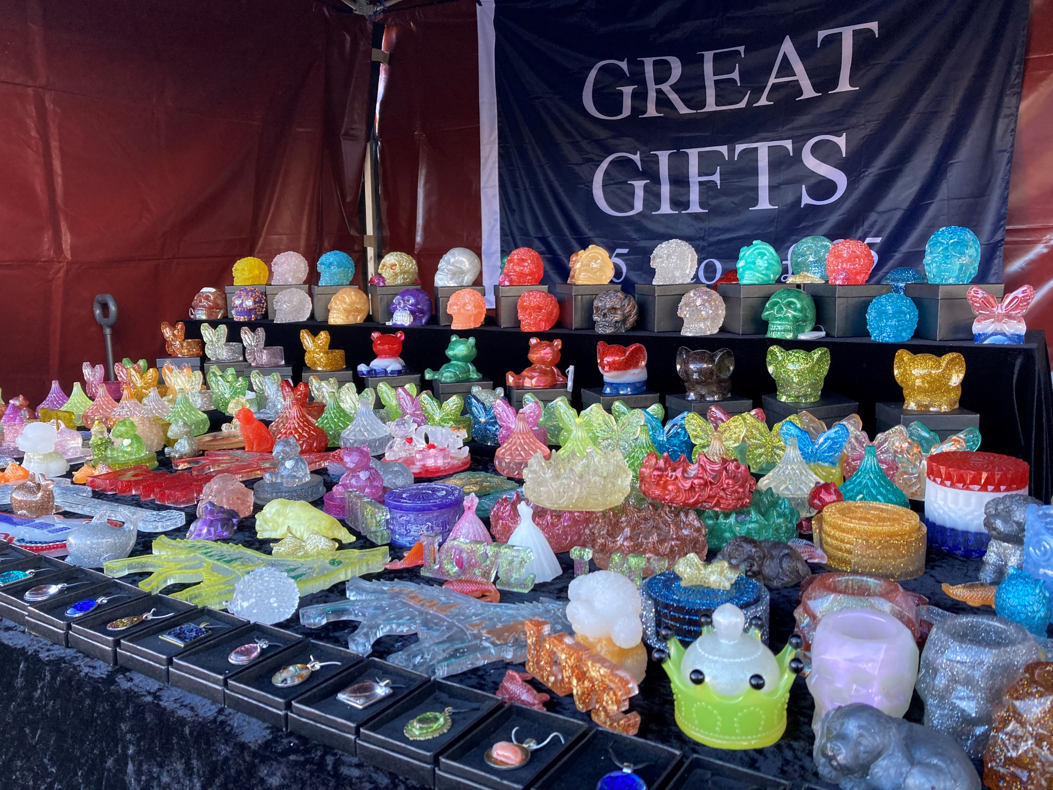
Growing the General Market

Slide 10
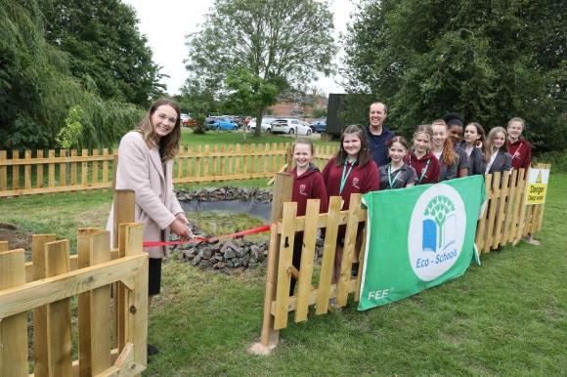
Supporting the Community

Slide 11
Objectives for 2024-25 (1)
Events - Ambitious programme including
A new half marathon event in March 2025
The second Love Food event in September 2024
Continuing and extending our existing events programme
Town Centre
Christmas lights
Hanging baskets and planting displays
Public toilets project for the town centre – free, safe, modern loos.
A new neighbourhood plan for the town centre and beyond
Supporting bio-diversity
Seed exchanges
Blister pack recycling
£8k to support projects and make grants, including Love Wildlife

Slide 12
Objectives for 2024-25 (2)
Community Services
New play area on the Ise –£7000 contribution
Investment in our allotments
Growing the general market
Another speed device
Supporting culture
Kettering Cultural Consortium
Kettfest
Town Lottery – focus on culture in 2024/5
Voluntary sector grants programme
£10k to help services which tackle mental ill health or address the cost of living crisis
Ward initiatives budget £10k
Core grant aid - £5k - to
Accommodation Concern
Kettering Homestart
Kettering Food Bank

Slide 13
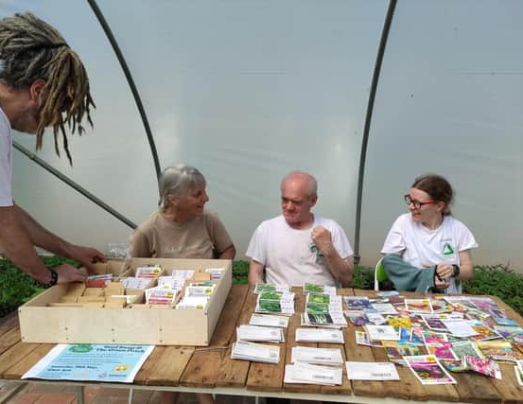
Bio-diversity
Allotments
Seed Exchanges
Love Wildlife Grants

